Slide 1

Welcomes
DAY 4
Boot camp

Slide 2
DAY 4 AGENDA
Topic | Topic Description | Estimated Time
Device Administration / global system settings | Device Categories Device Classes Device Dashboards Interfaces Mac Vendors TCP-IP Ports Global Thresholds Vanished Device Manager | 9am – 10:30
BREAK |  | 10:30 – 10:45
Ticket Administration | Customizing Tickets Ticket Queues Escalations Ticket Templates | 10:45 – 12:00
LUNCH |  | 12:00 – 1:00
Dynamic Applications | Types of Dynamic Apps Building Dynamic Apps Importing MIBs | 1:00 – 4:00 Break between

Slide 3
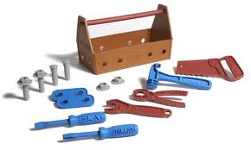
Device Administration

Slide 4

Device Administration Objectives
Device Categories
Device Classes
Device Dashboards
Interfaces
Mac Vendors
TCP-IP Ports
Global Thresholds
Vanished Device Manager
Resources
Lab and Questions
Device Administration

Slide 5

Section Overview
Device Administration in EM7 is made up of many features from adding devices that EM7 is not aware of, to administrating global device default settings and behavior.
This section will cover where to go to make these changes to help you maximize availability and optimize performance.
Device Administration

Slide 6
Use Case
The Challenge:
The need to add information to new devices discovered and have them have a global default setting when discovered by EM7.
The Solution:
Add a new device class and category to devices that have a “?” on the device icon and no manufacturer or model info to help operators quickly determine vendor and model of devices.
The Result:
All Devices discovered within em7 that match the system object ID will be automatically associated with the new vendor, device class, and icon.
Device Administration

Slide 7
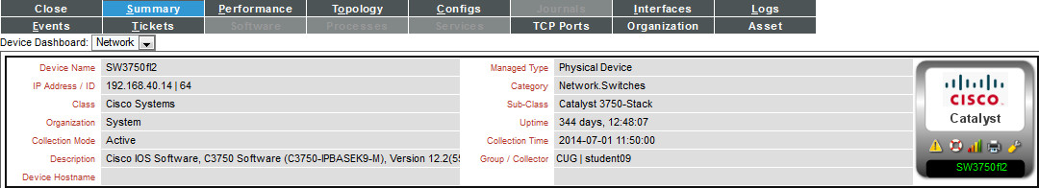
Device Categories
Device categories are paired with Device classes to organize and describe discovered devices.
Device class describes the manufacturer. Device category describes the function of the hardware.
Can be used to link a Device Dashboard to a device category, the selected device dashboard will appear as an option in the Device Summary page.
Device Classes: Specific
Device Categories: General
Device Administration

Slide 8
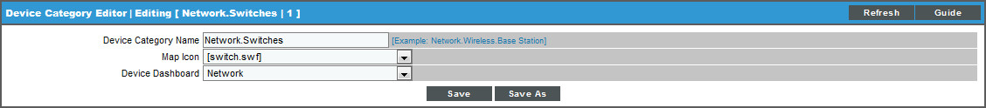
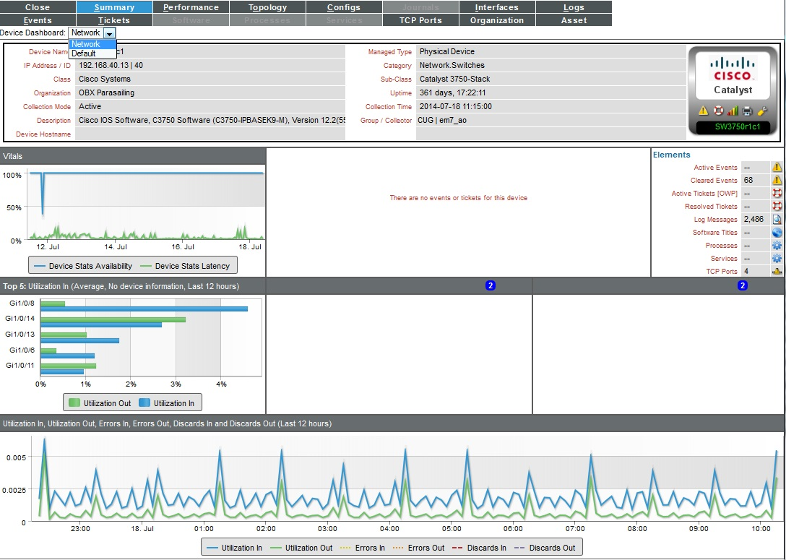
Device Categories: Editing
System > Customize > Device Categories
Device Category Name - Enter a name for the new device category.
Map Icon - The icon will be used to represent members of the device category in the device topology and custom maps.
Device Dashboard - Select a device dashboard from a list of all device dashboards in EM7. For devices with this device category, the selected device dashboard will appear as an option in the Device Summary page.
Device Administration

Slide 9
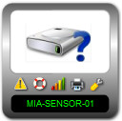

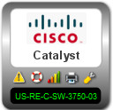
Device Classes
In EM7, each device is associated with a device class. Device classes map to make, model, categories and associated icon. EM7 automatically assigns each discovered device to a device class.
Device Classes can be included with Power-Packs.
Defines how devices are represented in the graphical user interface.
New Device Classes can be created as needed and does not require a MIB loaded in the EM7 Platform.
Device Administration

Slide 10
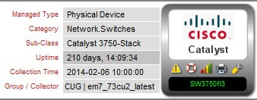
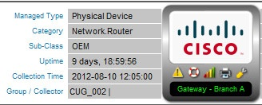
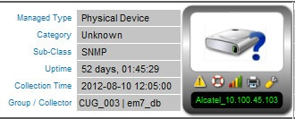
Device Classes: Types
1. SNMP enabled
During initial discovery, searches the SysObjectID for each device and assigns it to the appropriate device class. EM7 has almost 500 unique Private Enterprise Numbers (PEN) with 3300 unique device classes.
e.g. (.1.3.6.1.4.1.9.1.516) – MIB & Model exists in EM7.
A Private Enterprise Number exists in EM7 but no device class for this specific model exists. EM7 has hundreds of predefined device classes with OEM (Original Equipment Manufacturer) as its device class description. This will allow a device to align with its vendor OEM device class even without the exact model information.
e.g. (.1.3.6.1.4.1.9 ) – MIB exists in EM7 with vendor but no model, would want to create device class for model level.
No OEM or specific device class exists
e.g. (.1.3.6.1.4.1) – MIB does not exist in EM7.
Device Administration

Slide 11
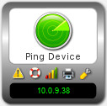
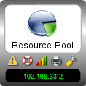
Device Classes: Types
2. Pingable - These device classes are associated with values returned by Nmap. Nmap runs against each device during discovery.
3. Component - EM7 discovers management systems and the component devices they manage. For example, EM7 can discover a VMware ESX server (management system) and then discover the virtual machines (component devices) running on that VMware server.
EM7 uses Dynamic Applications to retrieve data from a management system and discover each component device managed by that management system. Device classes for components are aligned with the Dynamic Applications that discover component devices.
Device Administration

Slide 12
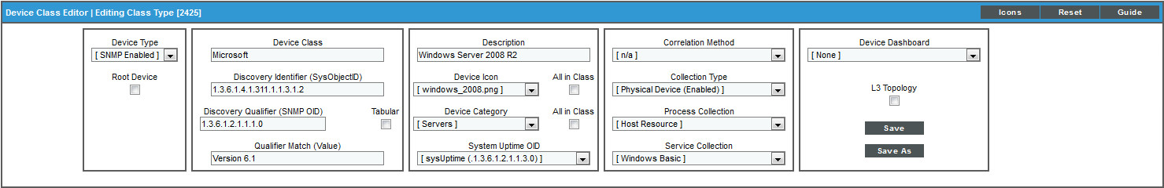
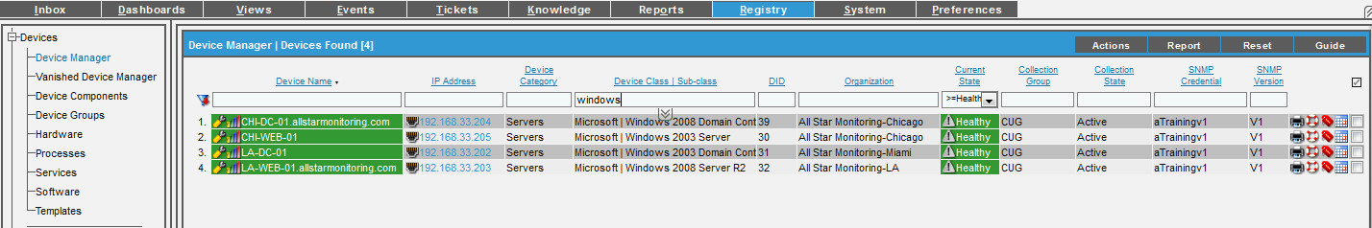
Device Classes: Views
System > Customize > Device Classes
Create new or edit existing device types, changes made reflect on the device and the registry
Registry Tab
View all classes
Device Administration

Slide 13
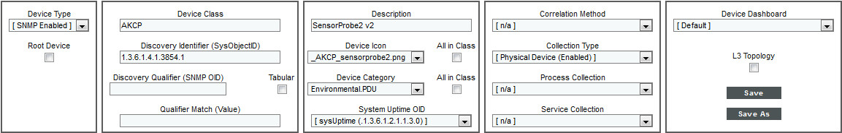
Device Classes: Type SNMP
System > Customize > Device Classes
Device Class - The name of the manufacturer who created the device.
Discovery Identifier (SysObjectID) - The SNMP OID, that is returned when querying the device's sysObjectID.
Discovery Qualifier (SNMP OID) - Optional field. This is used for a second level of qualification for matching down to the application level. Ex: Citrix running on windows server.
Qualifier Match - Optional field. Always looks at the value returned Discovery Qualifier OID String and have the Qualifier match against the returned model names.
Tabular - Performs an SNMP walk of the Discovery Qualifier (as opposed to an SNMP "get" request) and then search's for the value that matches the Qualifier Match field.
Device Administration

Slide 14
Device Classes: Type SNMP
Description - The model name of the device.
Device Icon - The icon used to display the device in the graphical interface. To view the available icons, select the Icons button. Select from drop-down list.
Device Category - A logical categorization of device by primary function. This field allows EM7 to group related devices in reports and views. Select a value from drop-down list. (System > Customize > Device Categories)
System Uptime OID - Specifies the OID to monitor to determine system uptime. (System > Customize > Uptime OIDs)
Device Administration

Slide 15
Device Classes: Type SNMP
Process Collection - Specifies how to retrieve process information for the device class.
Service Collection - Specifies how to collect information on Windows services.
L3 Topology - Includes devices in this device class in the Layer-3 Maps. EM7 uses Traceroute from each Data Collector to each of its managed devices to create Layer-3 maps.
Device Dashboard - Select a device dashboard from a list of all device dashboards in EM7. For devices with this device class, the selected device dashboard will appear as an option in the Device Summary page.
Device Administration

Slide 16
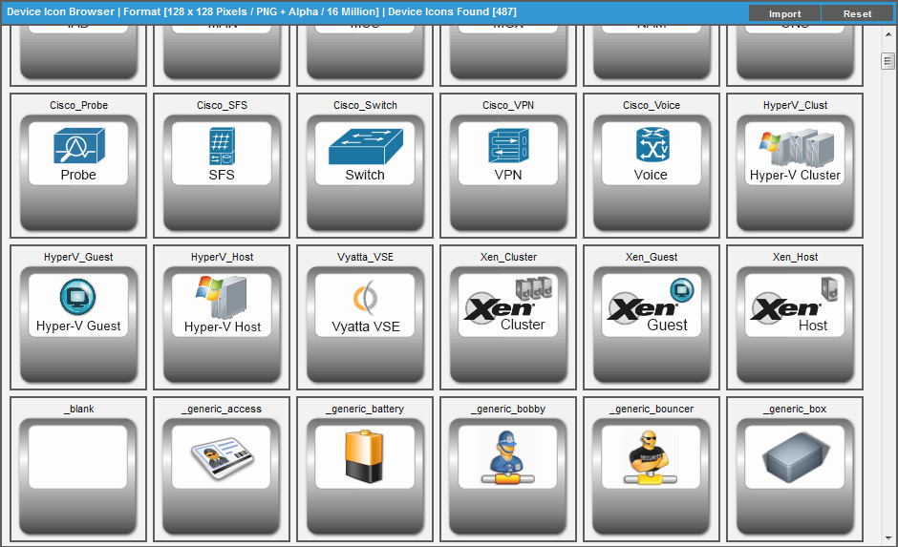
Device Classes: Build and Import Device Icon
System > Customize > Device Classes > Icons Button
Provides a listing of available device icons for device classes.
Copy the _blank icon to desktop and edit with PNG
To import an image to use as an icon, select the Import button.
Device Administration

Slide 17
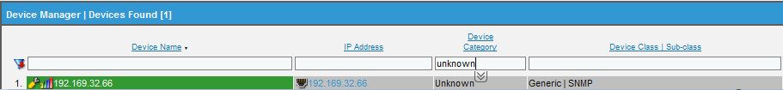
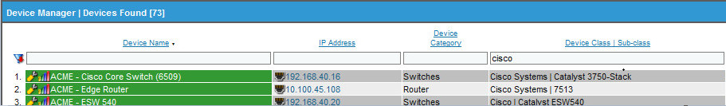
Device Classes: Best Practice
Registry > Devices > Device Manager
In Device Manager you can filter on the Device Class using “OEM” or “Unknown” under Device Category to see devices not fully defined in EM7.
Best practice is to have all your devices defined with the correct Private Enterprise Number in EM7. This allows your organization to quickly identify the category and product line for troubleshooting and reporting.
Device Administration

Slide 18

Device Classes: Generic SNMP
Registry >
If you see “generic” in the device class name column or “unknown” in the category column then you have a device that does not have a specific defined device class in the system.
This can be fixed with a new or improved device class.
The SysObjectID is required to create a new SNMP Device class.
SysObjectID is defined in the MIB2 RFC 1213, devices supporting MIB2 must provide a unique System Object ID defining the manufacturer.
SysObjectID is located in the System MIB.
Device Administration

Slide 19
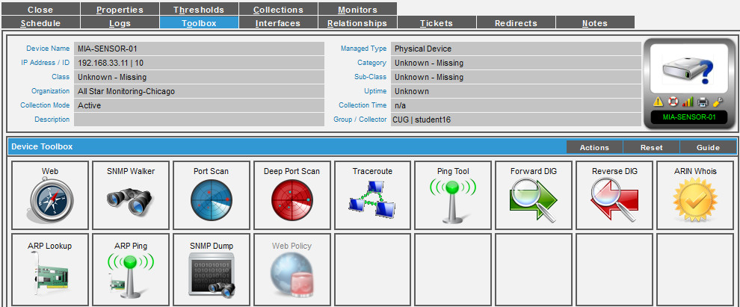
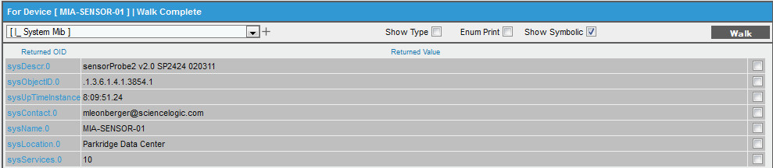
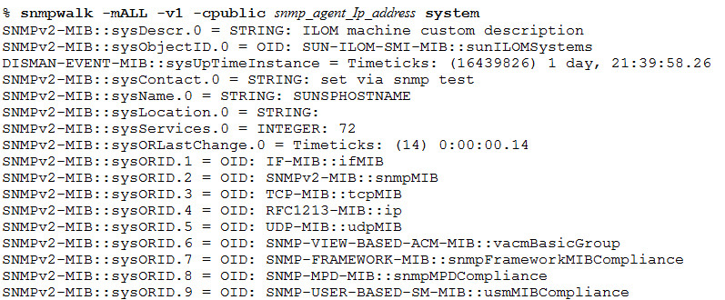
Device Classes: Finding the SysObjectID
Registry > Wrench > Toolbox > SNMP Walker
Find device, select “WRENCH”.
Select Toolbox tab.
Select SNMP Walker.
Select the System MIB from [Common OID’s] dropdown.
Select “Show Symbolic”.
Select “Walk button”.
Copy value and place in System > Customize > Device Class > Discovery Identifier (SysObject ID).
* Remove the first dot in the OID.
Command line SNMP walk
Device Administration

Slide 20
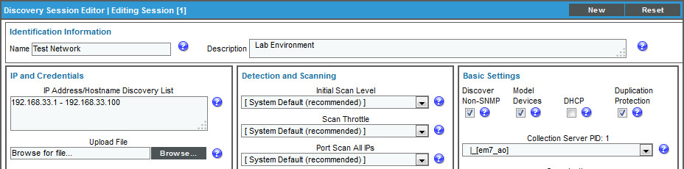
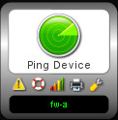
Device Classes: Pingable
Devices with a device category of "pingable" are devices discovered when the Discover Non-SNMP box was selected.
Why use Pingable?
Need to monitor a device that does not have SNMP or you have no credential.
By default only measures availability and latency via ICMP.
Device Administration

Slide 21
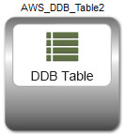
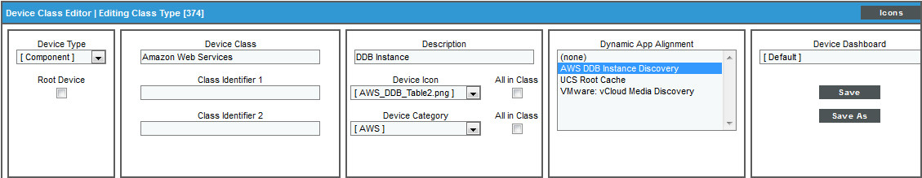
Device Classes: Component
An entity that runs under the control of a management system running on a root device for collection of some or all of the performance, configuration and status information relating to that device.
EM7 uses Dynamic Applications to retrieve data from a management system and discover each component device managed by that management system.
Device classes for components are aligned with the Dynamic Applications that discover component devices.
Device Administration

Slide 22
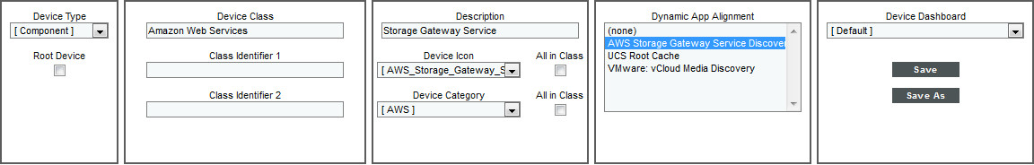
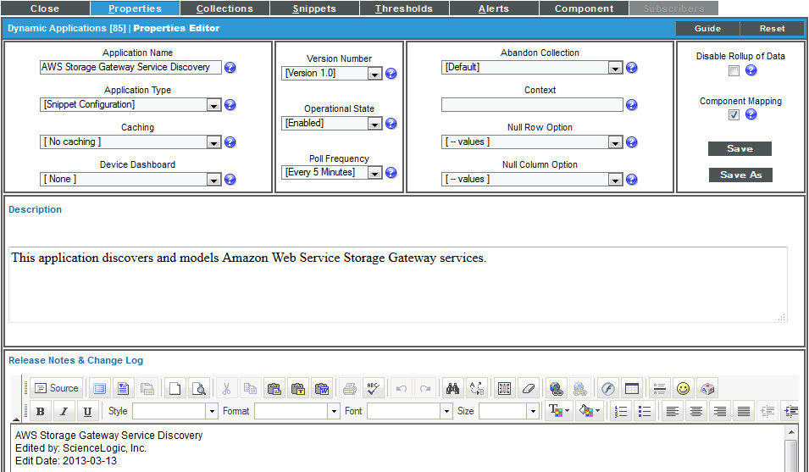
Device Classes: Type Component
Defining a device class that uses an aligned Dynamic Application to identify member devices.
Dynamic App Alignment - Each component device discovered by that Dynamic Application will be assigned to the current device class. This list will include all Dynamic Applications that have the Component Mapping checkbox selected in the Dynamic Applications Properties Editor page and are not currently being used by another device class.
Device Administration

Slide 23
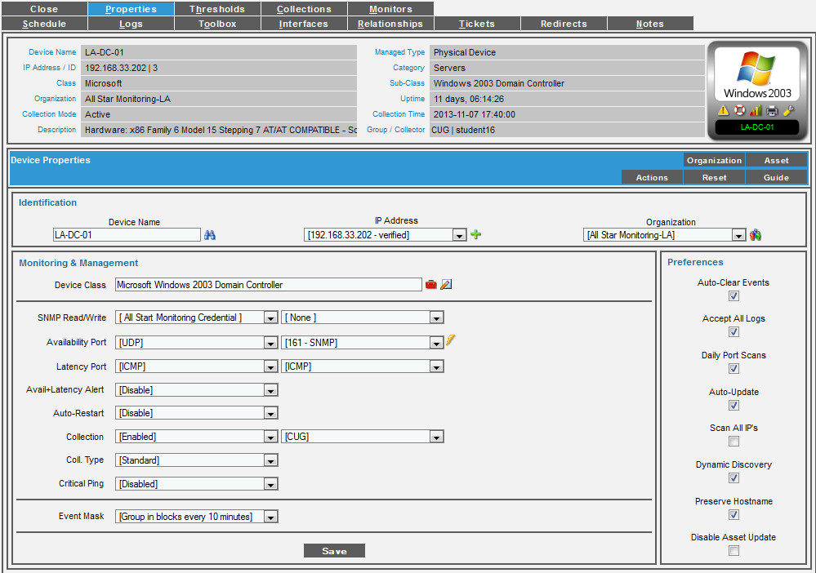

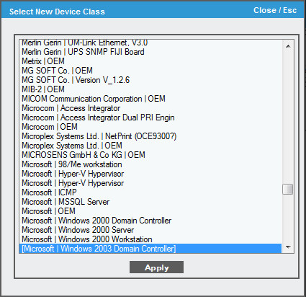
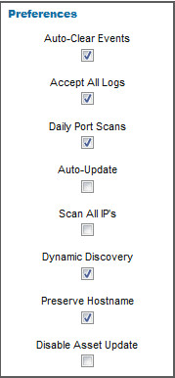
Device Classes: Select New
Registry > Devices > Device Manager
Device Class - Displays a list of all device classes in EM7. This page allows you to associate a device class with a device.
Auto-Update - Specifies whether or not you want EM7 to perform a nightly discovery of the device and update records with changes to the device. If this field is unchecked, EM7 will not perform nightly discovery. Changes to the device, including newly opened ports, will not be recorded by EM7.
Device Administration

Slide 24
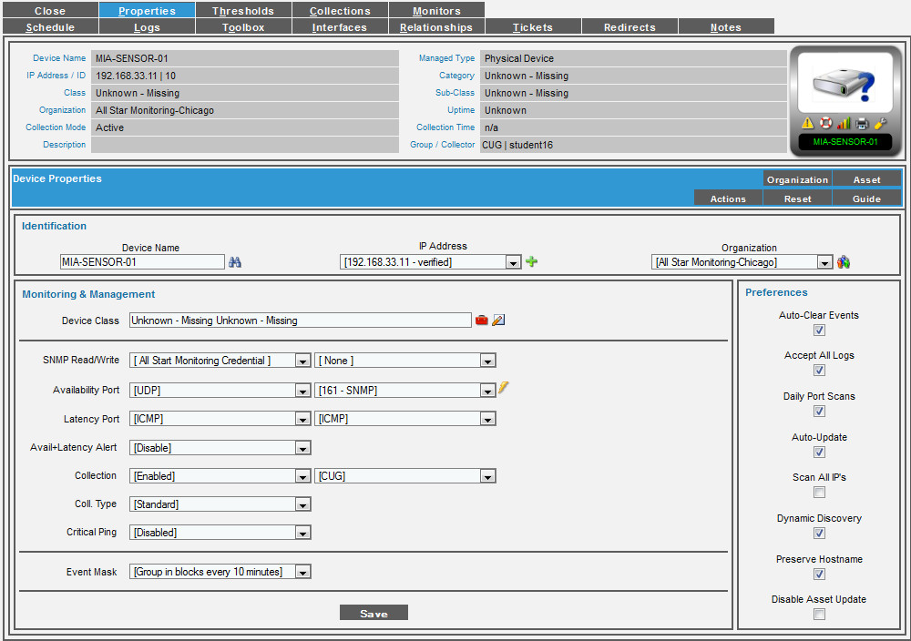
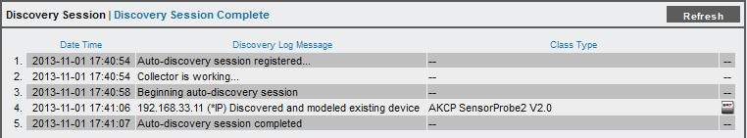
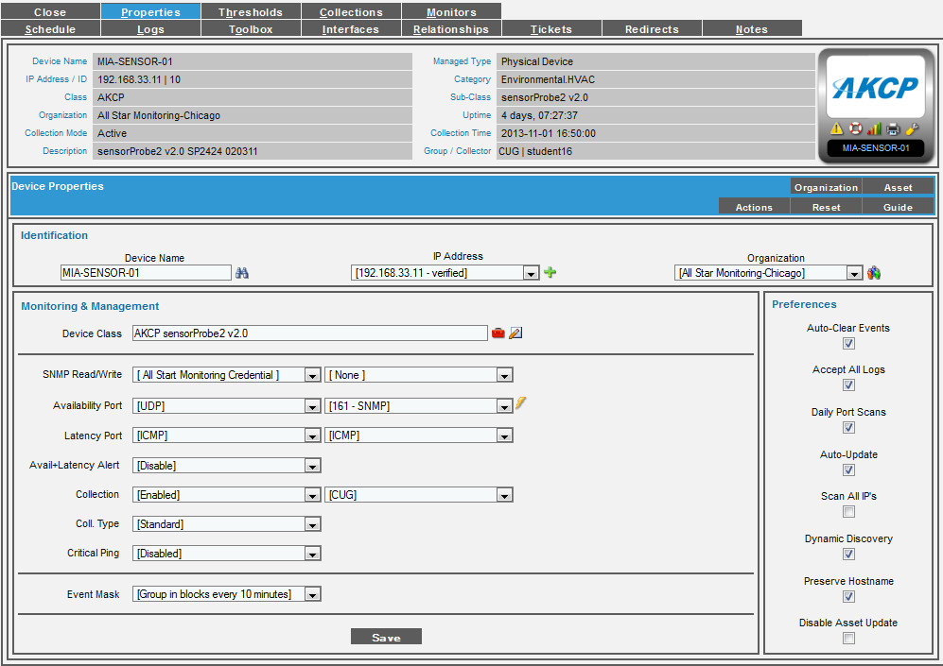
Device Classes: New Class Discovery
Registry > Device Properties
(Before Discovery)
(After)
Rediscovery icon updates category, class, and icon
Device Administration

Slide 25
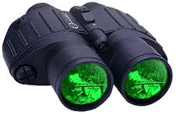
Device Classes: Discovery Update
The process discover_update.py runs every 24 hours for existing devices in EM7 and looks for changes to:
New open/closed ports
SSL Certificates
Aligns Dynamic Applications based on Discovery Object
Interface changes
Device classes
Device Administration

Slide 26

Lab
Watersports Management has made a request for you to:
Tasks:
Provide a way for the NOC team to determine the type of device they have in the registry that has no class, description, or category when they discovered it. (AKCP-PROBE-01)
Requirements:
To accomplish this you will need to look for the device in the registry with a “generic” class and walk the SysObject ID.
Research the OID on “Google” to find out more information about the device.
Create the class, description and category along with the icon.
Device Administration

Slide 27
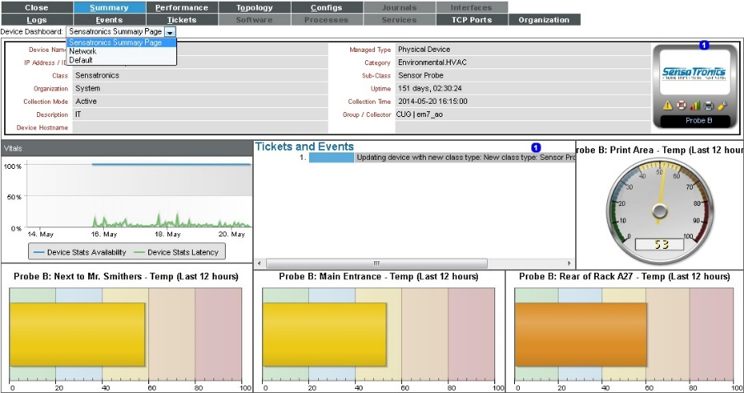
Device Dashboards
The Device Dashboard brings the ability to use context driven widgets to the Device Summary Tab
Same as creating Dashboards in the Dashboards Tab
5 ways to assign Device Dashboards:
Global Default
Device Category
Device Class
Device Properties
Dynamic Applications * For dynamic apps that the device is subscribed to
"private" or "per-user" device summary dashboards are not supported
Display Performance and configuration data on the same dashboard
Device Administration

Slide 28

Device Dashboards
The order of precedence for which Device Dashboard will display is based on:
Device Properties
Device Class
Device Category
Global Default
"Global Default" is the default dashboard that appears in the Device Summary page for each device.
Device dashboards that are aligned with Dynamic Applications are never displayed in the Device Summary page as the default display. However, from the Device Summary page, a user can select and view any device dashboards that are aligned with Dynamic Applications for the device.
ScienceLogic provided dashboards may not be edited, but you can make a copy, edit it, and set it as the replacement for the ScienceLogic version.
Device Administration

Slide 29
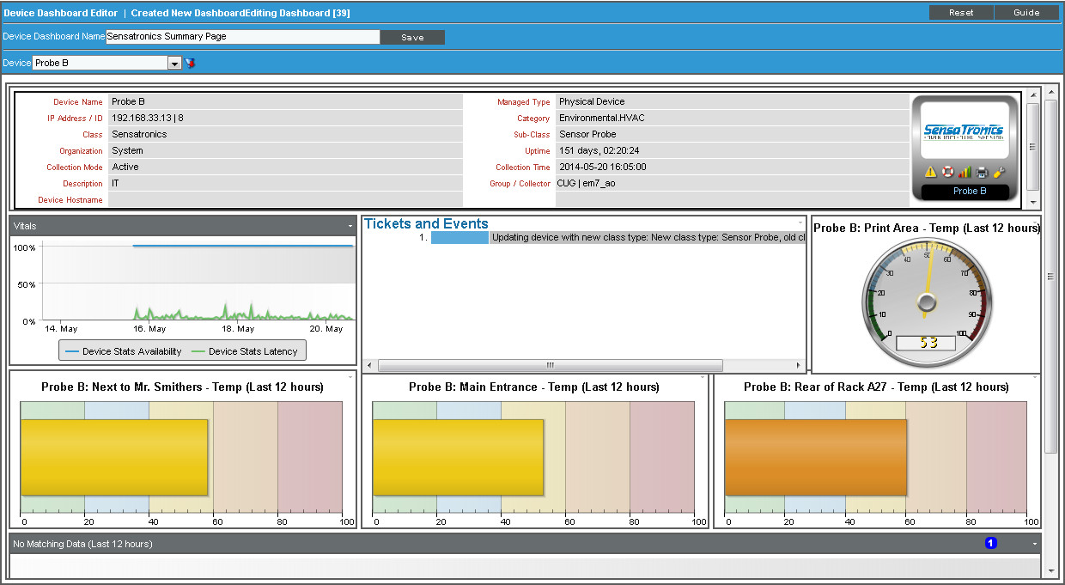
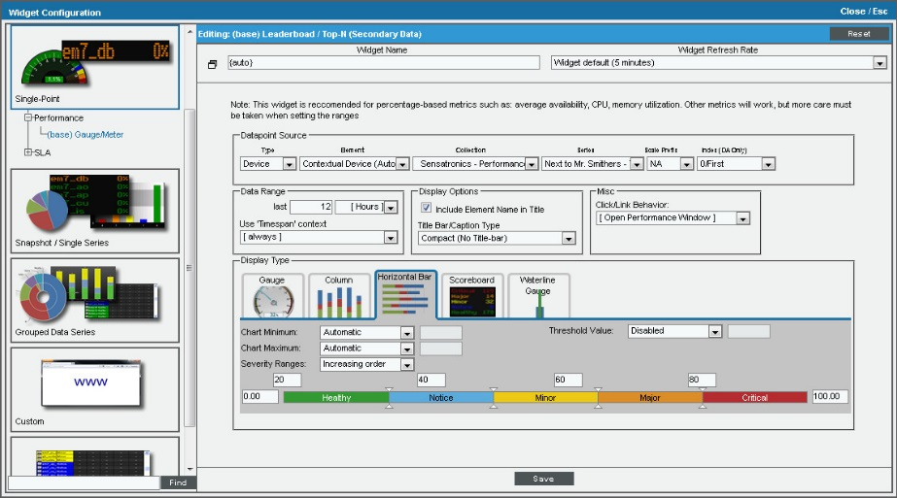
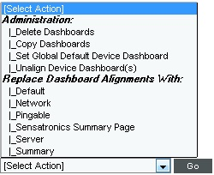
Device Dashboards: Create
System > Customize > Device Dashboards
Device Dashboard Name - Name of the device dashboard.
Device - Select a device to provide sample data while you create the dashboard.
Add Widgets - No save just like dashboards
Select Action: Provides bulk administration and Dashboard Alignments
Device Administration

Slide 30
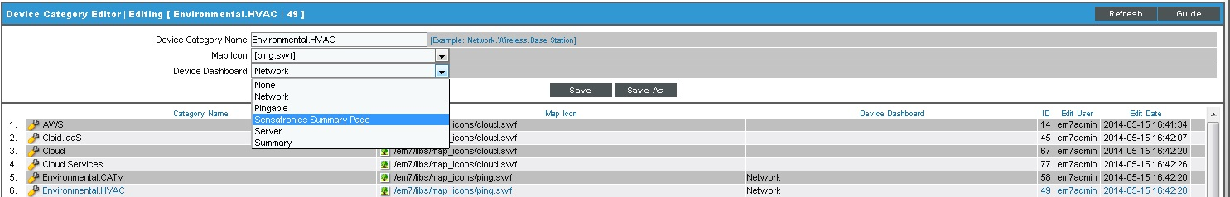
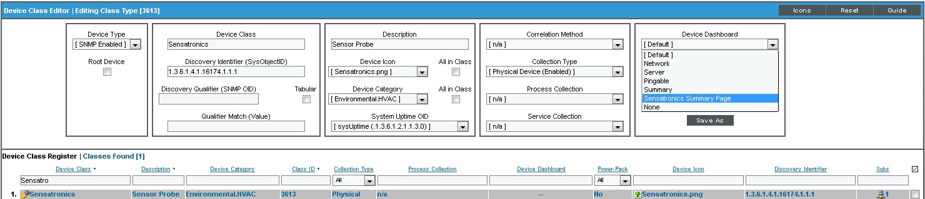
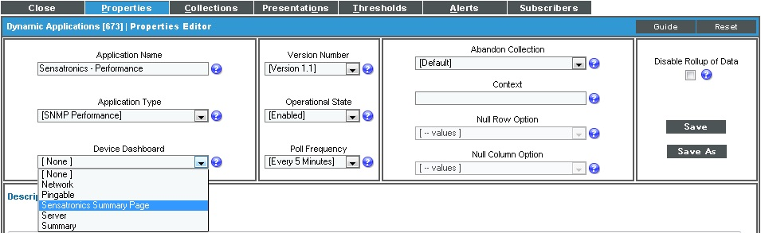
Device Dashboards: Assignment
System > Customize > Device Categories
NOTE: As a general rule, only use Device Categories when all devices in that category share the same KPIs
System > Customize > Device Classes
System > Manage > Applications Wrench > Properties
Device Administration

Slide 31
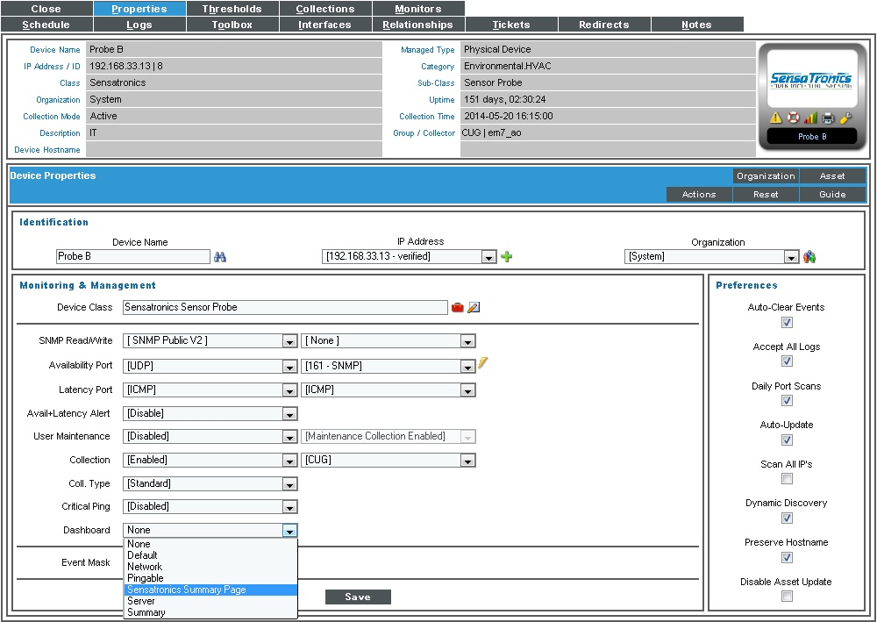
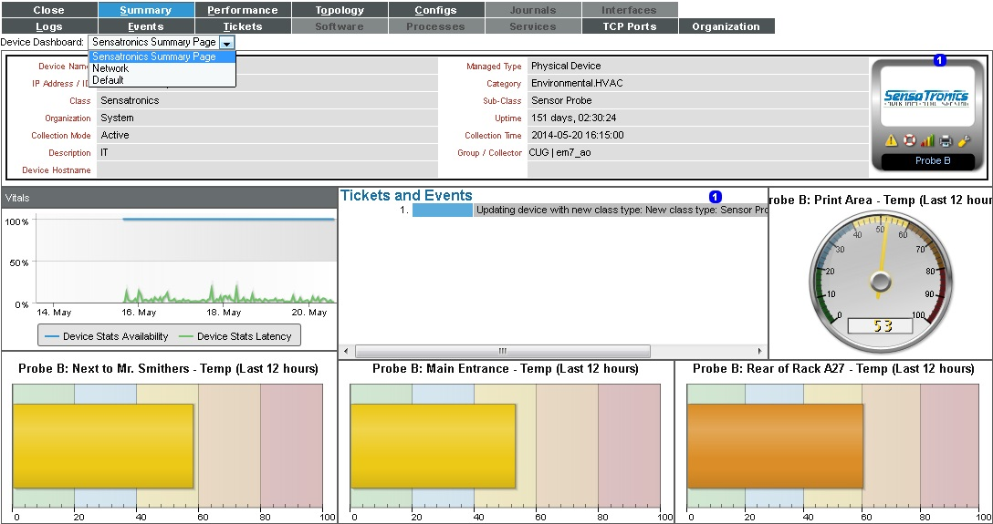
Device Dashboards: Assignment
Registry > Device Administration > Wrench > Properties
Device Reports > Summary > Device Dashboard: This list shows:
Global Default
Device Category
Device Class
Device Properties
Dynamic Applications if they match the device
Also any device specific dashboards that have been saved in Device Properties
All device dashboards are available from this drop-down and can be applied to just this device
Device Administration

Slide 32
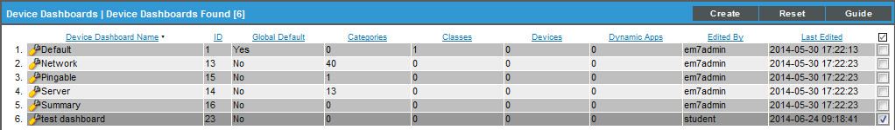
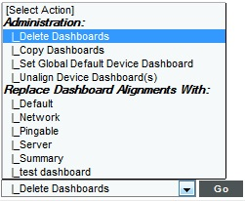
Device Dashboard: Delete
System>Customize>Device Dashboards
Select dashboard(s) to delete
Select Delete Dashboard from Bulk actions menu and Go
Device Administration

Slide 33
Lab
NOC operators are getting their first look at the ScienceLogic product and have made suggestions.
Tasks:
NOC operators have requested that the SW3250r2c1 device have the same summary info that is currently displayed for their Cisco switches.
The operator wants the widget Custom > Configuration > Host Resource: Memory Configuration Dynamic Application on the dashboard of the CORP-AD systems instead of the event info.
Watersports will be adding more AD servers in the future and want this device dashboard to be available for all the Microsoft Windows Server 2008 R2 Domain Controllers.
Requirements:
Assign SW3250r2c1 a new dashboard.
Create a Device Dashboard, swap out events for Memory Configuration.
Assign to all Microsoft Windows Server 2008 R2 Domain Controllers
Device Administration

Slide 34
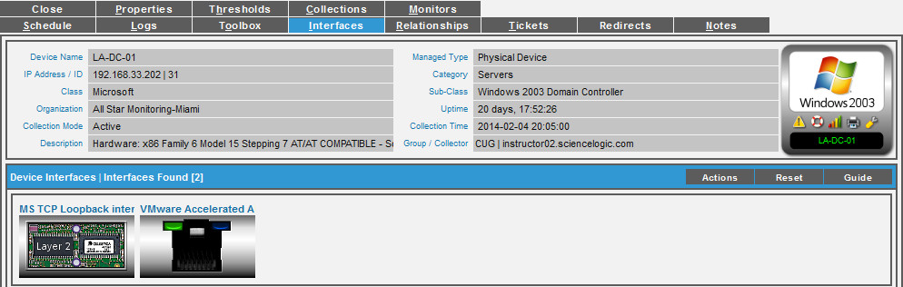
Interfaces
This feature allows you to set interface types to hidden so they will not collect data or generate events.
The settings in the Interface Type Editor page are global and affect all EM7 devices.
Once an interface is hidden it will be removed from the device properties and the interfaces registry.
By default software loop back interfaces are hidden.
Hide interfaces not important
Device Administration

Slide 35
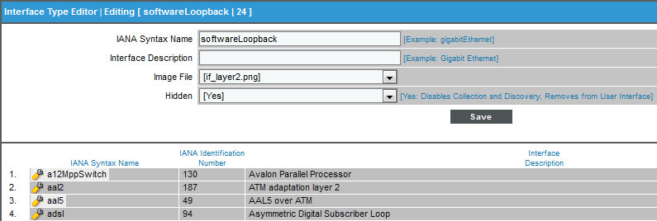
Interfaces: Type
System > Customize > Interfaces
Do not edit this value. Select an interface from the Register and select its wrench icon. This name is defined in the IANAIfType MIB file.
Yes - EM7 will not discover the interface type
No - EM7 will discover the interface type
Device Administration

Slide 36
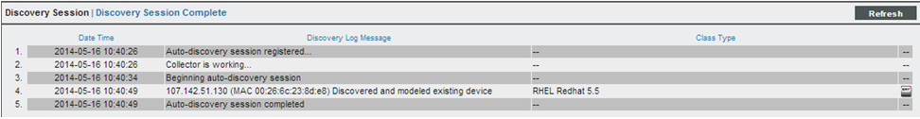
MAC Vendors
MAC addresses used to be unique per device, today with virtualization technology multiple devices may have the same MAC address.
To solve this challenge EM7 allows you to set the MAC prefix to virtual which will allow devices to be discovered based on uniqueness of their IP address versus MAC address.
EM7 does not allow the same MAC address to be associated with multiple discovered devices unless the MAC Vendor Record has a virtual setting of "yes".
If you attempt to discover a unique IP address that has the same MAC address as a pre-existing IP address in the system you will receive this message in the Discovery Log:
Device Administration

Slide 37
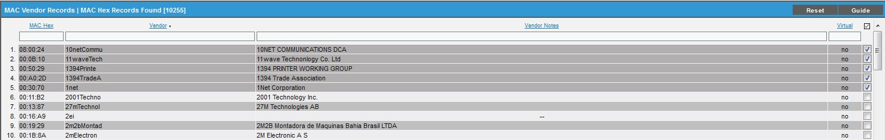
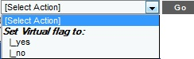
MAC Vendors: Bulk Actions
System > Customize > MAC Vendors
Virtual Settings:
Yes - The vendor allows the same MAC address to be re-used on multiple devices.
No - The vendor does not allow the same MAC address to be re-used on multiple devices.
Change settings in bulk
Device Administration

Slide 38
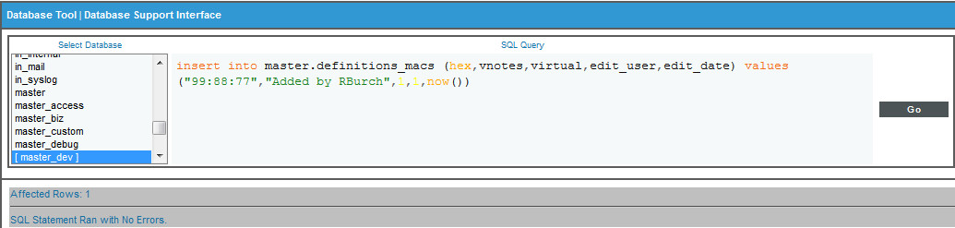
Mac Vendors: Record Adding
You will know you need to set the MAC vendor to virtual if you try to discover the device and get “Discovered and modeled existing Device”
Search the MAC Vendor records to see if MAC exists, if so set the virtual flag to :Yes” , Then re-run discovery
If unable to locate the MAC hex you will need to add an entry to the MAC Vendor table. Currently this requires using a MySQL query:
insert into master.definitions_macs (hex,vendor,vnotes,virtual,edit_user,edit_date) values (“xx:yy:zz",”Vendor Name”, "Added by usr name",1,1,now() )
Navigate to System > Tools > DB Tool, then paste in the query
The xx:yy:zz should be the first 3 octets of the MAC address from the discovery message
Also replace vendor with vendor name
Add usr name, ex: Jdoe
Search in MAC Vendor for entry just created and make sure it is set to “yes” and re-run discovery
Device Administration

Slide 39

Global Thresholds
Thresholds allows you to define default threshold settings for new devices as they are discovered and modeled in EM7.
Global settings for:
OS Thresholds
Counter roll overs
Interface and Bandwidth thresholds
ICMP availability thresholds
Component Device
Device thresholds settings override these global settings
Changing the global settings are not going to override device thresholds
All devices added to the system inherit these settings unless added with a device template that override one of these settings
Device Administration

Slide 40

Thresholds
System > Settings > Thresholds
These settings apply to all devices and all interfaces on all devices.
Operating System Thresholds
Counter Rollover Thresholds
Bandwidth/Interface Thresholds
ICMP Availability Thresholds
Component Device Thresholds
Slide bar to value or type number in field
Device Administration

Slide 41


Vanished Device Manager
Managing Transient Workloads
Elastic compute:
Characteristic of cloud environments
Device Components come and go, can be short-lived
What happens when short-lived Device Components go away?
What happens if it comes back?
Device Administration

Slide 42
Use Case
The Challenge:
Customers turn on instances of VM’s and EM7 models them as a device components, how does EM7 handle these when the customer turns off instances?
The Solution:
Vanished Devices Gives back control of behavior when device components are no longer visible in the cloud.
Have device components “vanish” from EM7 but keep history should it return.
Have device components “purge” if history is not required.
The Result:
Automated Device Components management.
Device Administration

Slide 43

Vanished Device Manager
If EM7 cannot retrieve information about a component device from a root device for the amount of time specified in the Component Vanish Timeout field, EM7 sets the device to "vanished".
When a device is set to "vanished", EM7 stops trying to collect data about the component device. The vanished device will not appear in reports or views, and appears only in the Vanished Device Manager page.
If the discovery Dynamic Application resumes collecting information about the device prior to the device component being purged, it will be added back as a device component.
Setting Component Purge Timeout specifies when Vanished Devices will then be deleted from the Vanished Device Manager page and from the database.
Vanished devices only apply to component devices.
Device Administration

Slide 44


Vanished Device Manager: Viewing
Registry > Devices > Vanished Device Manager
Vanished Date. Date on which the device was set to "vanished".
Hours Until Purge. Based on the threshold Component Purge Timeout, specifies the number of hours until the vanished device will be purged.
Bulk Actions
Device Administration

Slide 45


Vanished Device Manager: Threshold Settings
Two locations for setting the component vanished and component purge timeout thresholds:
System > Settings > Thresholds
Device Administration Panel> Thresholds Tab
Global setting Default is “0”
Single device setting
Default is “0”
Component Vanish Timeout - This threshold specifies how many hours to wait until putting the component device into "vanish" mode. If this threshold is set to zero for a component device, the component device is never set to "vanished".
Component Purge Timeout - This field specifies how many hours to wait until purging the component device. When a device is purged, all of its configuration data and collected data is deleted from EM7. If this threshold is set to zero for a component device, the component device is never purged.
Device Administration

Slide 46


Resources and Questions
For more information:
Sciencelogic Customization
ScienceLogic Device Management
Guide Button
Reports and Dashboard Widgets
Access Hooks and Keys
Process, System Settings, and Data Retention
API
All manuals are available on the Customer Portal:
http://portal.sciencelogic.com
Device Administration

Slide 47

Ticket Console

Slide 48
Objectives
Benefits of EM7 Ticketing
What is a Ticket?
Ticket Console
Creating Tickets
Viewing Tickets
Resolving Tickets
Ticket Watchers
Ticket Queues
Ticketing Console

Slide 49

Benefits of Ticketing in EM7
Integrate event and ticketing for seamless operations
Automate notifications, escalations, and response/remediation
Align processes to customized workflows
Ticketing Console

Slide 50

What is a Ticket?
A ticket is a request for work and a log of the work.
A ticket can be created manually or created based on an event.
From the Ticket Console page, you can:
View a list of active tickets
Create a new ticket
Edit one or more existing tickets
Filter, search, and sort the list of tickets
Generate reports for one or more tickets
Ticketing Console

Slide 51

Ticket Console
Tickets Tab
Screen refresh timer
Find-while-you-type filters
Sort ascending/descending
Save filters to create Custom View’s per user
Default sort is for Open/Working/Pending (Resolved not shown)
Create new tickets
Report of either the list of tickets or on an individual ticket
Bulk actions including Bulk Resolve
Send ticket as a Message
Filter for Status “resolved” to see list of resolved tickets
Ticketing Console
Notes:
To create a ticket based on an event:
In the Event Console page, select the event for which you want to create a ticket. Click on its life-ring icon.
2. The Create New Ticket page appears.
3. Notice that most of the fields are already populated with values from the event. You can accept these values or edit them.

Slide 52
Ticket Console Icons
Icon | Purpose
 | Filters icon
 | Ticket Editor icon
 | Device Administration icon
 | Ticket Summary icon
 | Send a message icon
 | Report Creator icon
 | Parent Ticket icon
 | Checkbox icon
Ticketing Console
Notes:
Filters. Shows the advanced search features of the Ticket Console.
Ticket Editor. Leads to the Ticket Editor page for the ticket, where you can view and edit details about the ticket and access the other pages in the Ticket panel.
Device Properties. Displays the Device Properties for the device.
Ticket Summary. Displays the Ticket Summary modal page, where you can view an overview of the selected ticket.
Send a message. Leads to the Send Message page, where you can send an Email message about the ticket.
Report Creator. Displays the Report Creator modal page, where you can generate a report about all the tickets in the Ticket Console page.
Parent Ticket. Displays the Parent Ticket Summary modal page, where you can view an overview of the parent ticket.
Checkbox. Allows multiple selection for tickets also using the Select Action menu.

Slide 53



Ticket Console Reports
Tickets Tab
[Actions] Generate Report provides listing of all tickets on screen
Individual ticket [Printer] icon provides individual ticket report
Ticketing Console
Notes:
To create a ticket based on an event:
In the Event Console page, select the event for which you want to create a ticket. Click on its life-ring icon.
2. The Create New Ticket page appears.
3. Notice that most of the fields are already populated with values from the event. You can accept these values or edit them.

Slide 54

Creating Tickets
Tickets > Create
None of the fields are required, but at a minimum fill out:
Description
Severity
First note
Ticketing Console

Slide 55
Opening Existing Ticket
Tickets Tab
Methods to open ticket on the Ticket Console:
Click the wrench for the ticket
Double click the description of the ticket
Click the ticket ID number
Click the “i” icon and then the [Edit] button
Ticketing Console

Slide 56

Viewing Ticket
Tickets > Ticket Editor
Main Ticket Editor items:
TID listed at top, each ticket has a unique id number that will not be repeated
Logs tab: record of modifications to ticket
Message: send out email version of ticket
Actions: various important operations that can be executed
Ticketing Console

Slide 57

Ticket Logs
Ticket Editor > Logs
Ticket logs show all modifications to the ticket:
What user modified the ticket (user account, automation, or escalation)
Date/time stamp of the modification
How long since the creation of the ticket to when the modification took place
To whom the ticket is assigned (if applicable)
Ticketing Console

Slide 58

Ticket Send Message
Ticket Editor > Message
Send an email version of the ticket:
Convenient way to send all or part of the ticket to email recipients
Your account email is the “Senders Address”, but this can be modified
Choose between HTML, text, or pager formatting
User can include or exclude logs
Ticketing Console

Slide 59


Resolving Tickets
Ticket Editor > Action > Resolve Ticket
Tickets can be resolved per ticket or in bulk
Resolved tickets have a default 10 year retention policy
ITIL best practices determine that resolved tickets are not deleted
In the ticket editor the resolve function is available under [Actions] button or on dedicated [Resolve] button
Ticketing Console

Slide 60

Resolve a Ticket
Ticket Editor > Action > Resolve Ticket
The Ticket Resolution modal allows for the selection of Cause and Resolution
Events that are aligned to the ticket can be cleared with “Clear Aligned Events” checkbox
Email Recipients are determined by the Watchers
Ticketing Console

Slide 61


Bulk Resolve Tickets
Ticket Console > Select Action > Resolve Tickets > Go
A Cause and Resolution entry should be put in for all resolved tickets
All of the tickets selected will get the same changes and be resolved in one action
Ticketing Console

Slide 62

Ticket Watchers
Ticket Editor > Actions > Watchers
Ticket Watchers are users who will receive email updates when the ticket is modified and the [Save] button is clicked
The default watcher is the first user assigned to the ticket
Watchers can be both added and removed
Ticketing Console

Slide 63

Ticket Queues
Registry > Ticketing > Queues
Ticket queue membership is determined per queue
Email Last Ticket Comment in Updates used in conjunction with Notify Watchers of Changes will cause watchers to get the text of the most recent update in the update email.
Ticketing Console

Slide 64


Pro Tip: Recurring Tickets
Tickets can be set up to recur on a scheduled basis. This is great for repeating tasks that need to be handled with a trail of accountability.
Ticketing Console

Slide 65

Lab: Ticket Console
Create, Review, and Resolve a ticket
Click [Tickets] then [Create] to open the Ticket Editor
In Description enter “Ticketing Lab test ticket”
For the Organization dropdown pick Miami Allstar Monitoring
In Queue choose Monitoring
Click [Actions] then Element Alignment, search for LA-WEB-01 and click the Life Ring icon
Click [Actions] then Event Alignment and choose an event, hit [OK]
Move the cursor to the Notes field and enter some text
Click the [New Note] button and add another note
Click the [Descending] button and observe that the notes changed position
Click the [Maximize] button to maximize the notes area
Click the [Restore] button to go back to the default view of the Ticket Editor
Click [Save]
Close the Ticket Editor
Ticketing Console

Slide 66
Lab: Ticket Console
Create, Review, and Resolve a ticket
Return to [Ticketing] and find the ticket that was just created
Open the ticket by clicking the [Wrench], the Description, or the TID
Change Severity to Critical and [Save]
Click the [Logs] button and review the logs, notice the last Severity change
Click [Actions] then Watchers
Choose and additional watcher and hit [Add Watchers], close the modal, click [Save]
Click the [Logs] button and review the logs, notice the watcher addition
Click the [Action] button and choose Resolve Ticket
Pick the Cause and Resolution items, uncheck the Cloak checkbox
Click [Resolve]
Close the Ticket Editor
On the Ticket Console enter “resolved” in the Status field find while you type header in order to see the resolved ticket
Ticketing Console

Slide 67

Ticket Administration

Slide 68

Objectives
Queues
Escalations
Customization
Ticket Templates
Email Tickets
Run Book Automation Tickets
Scheduling Recurring Tickets
Resources
Labs and Questions
Ticket Administration

Slide 69
Section Overview
ScienceLogic Ticketing has a number of features that, when used in conjunction, can automatically create tickets, organize them in queues, escalate them based on conditions, and notify users of changes. Tickets can be customized by adding in custom fields or tab forms so that tickets meet your individual operational needs. All ticketing features are included in EM7 and do not require any additional licensing.
EM7 Ticketing System
Customer Created
Engineer Created
Ticket from customer email
Automated ticket from Event
Recurring Ticket Scheduler
Customer Request Queue
Incident and Change Management Queues
Ticket Administration

Slide 70

Ticket Queues
EM7's ticket queues allow you to organize and filter tickets. Organizing tickets by ticket queues and then aligning users to those queues means that users will only see tickets that are relevant to him or her.
Users can belong to multiple queues
Certain hooks allow a user to see their ticket regardless of what queue it is in
Queue: Asset Management
Ticket: 1
Ticket: 2
Queue: Help Desk
Ticket: 3
Ticket: 4
Queue: Facilities
Ticket: 5
Ticket: 6
Ticket Administration

Slide 71

Ticket Queues: Editing
Registry > Ticketing > Queues > Wrench or Create
Selected Custom Tab Forms will only appear when a ticket is in this Queue
Settings determines if the content of the last ticket update will be sent to watchers
Queue Membership is configurable in:
- Queues Editor
- User Accounts
- User Policies
Ticket Administration

Slide 72
Ticket Queues: Properties
Customization Features
Custom Forms – tickets in this queue will get selected Custom Forms. This is required in order for a ticket to have a custom form.
Required Fields – specifies which fields in the Form Field are required to have information prior to the ticket saving successfully.
Queue Administrator – User who is visible to all members of the queue and to whom all members, regardless of account type or organization, can assign tickets. (By default, Users can assign tickets only to queue members who are in their organization and to the Queue Administrator.)
Ticket Email Type:
Queue Email Address – when using the Message tab feature in an individual ticket the “From” field
Authenticated User – The From field in outgoing Emails from the [Message] tab in the Ticket Editor page will contain the name of the user who last edited the ticket.
Queue Communication Features:
Queue Watchers – the email icon ( ) allows for the assignment of user accounts as default watchers of any tickets in this queue
Notify Watchers of Changes – will send email to all Watchers when a ticket is created, assigned, or changed.
Email Last Comment in Updates – will send the text of a ticket update (not the attached files) to the list of Watchers
Hide queue name from non-queue members – prevents the queue name from displaying in the queue dropdown for users that are not
Ticket Message Tab controls:
Ticket Email Type – when using the Message tab feature in an individual ticket, this setting determines if EM7 will use the “Queue” email address or the “User” email address in the “From” field.
Queue Email Address – specifies the email address
Ticket Administration

Slide 73

Ticket Queues: Delete
Registry > Tickets > Queues
A queue can only be deleted if it has no tickets in it in any status (Open, Working, Pending, and Resolved). Once all tickets have been moved to another queue the queue can be selected and the Delete option used.
Ticket Administration

Slide 74
Create the following Ticket Queues:
Name | Field
Customer Support | Description: Customer requests Custom Forms: None Required Custom Fields: None Queue Administrator: None Ticket Email Type: Authenticated User Queue Email Address: support@watersports.com Notify Watchers of Changes: Check Queue Locked to Admin Only: Not Checked Email Last Ticket Comment in Updates: Check Hide queue name from non-queue members: Check Queue Members: All users
Network Provisioning | Description: Requests for Network Custom Forms: None Required Custom Fields: None Queue Administrator: gnoll (Select him as user and then admin) Ticket Email Type: Authenticated User Queue Email Address: support@watersports.com Notify Watchers of Changes: Check Queue Locked to Admin Only: Not Checked Email Last Ticket Comment in Updates: Check Hide queue name from non-queue members: Check Queue Members: Only Watersports.com org members
Ticket Administration

Slide 75
Creating Tickets for Elements
These elements in EM7 can be aligned in a ticket. Usually this is accomplished using the Life Ring icon on the elements Registry page.
Element Name | xtype ID | Ticket Create
Organization | 0 | Registry > Accounts > Organizations > Life Ring Organizational Summary Page Actions button drop down
Device | 1 | Registry > Manage > Device Manager > Life Ring Device Administration Panel Actions button drop down
Asset | 2 | Registry > Assets > Asset Manager > Life Ring Asset Properties Actions button drop down
Vendor | 6 | Registry > Accounts > Vendors > Life Ring Vendor Profile > Options button drop down
User Account | 7 | Registry > Accounts > User Accounts > Life Ring
IT Service | 10 | Registry > IT Services > IT Service Manager > Edit an IT Service > Tickets tab > Actions button
Ticket Administration

Slide 76
Escalations
Escalation policies allow you to define logic that automates ticket escalation for a specific ticket queue.
Each escalation policy can act on a specific ticket only once; a single policy cannot escalate a specific ticket multiple times.
Notify Manager Example
Notify and Move Ticket Example
Condition:
Ticket in Help Desk queue for more than 59 minutes and not assigned
Action:
Send Escalation email to the Manager
Condition:
Ticket in Help Desk queue for more than 6 hours without an update
Action:
Send notification email to the Manager and move ticket to Help Desk: Escalation Queue
Ticket Administration

Slide 77
Use Case: Escalations
The Challenge:
Notify the NOC Manager if there is a ticket in the Help Desk New queue for 59 minutes without an update. In addition, a ticket in this condition should have cloaked note added to it that indicates that it was in danger of an SLA violation.
The Solution:
Create an Escalation policy for the Help Desk New queue with an Escalation Condition of Open | > Healthy | Age > 59 min | and ticket is not updated
Set the Escalation Action of this Escalation Policy to make no changes to the ticket, but to Notify selected queue members
Select the NOC Manager as the notification user account
Fill in the message text and check the “Cloaked” checkbox
The Result:
Tickets in the Help Desk New queue for more than 59 minutes without an update will cause an email to go to the NOC Manager letting them know that there is a ticket waiting and possible going into an SLA violation. Additionally there will be a cloaked note in the ticket indicating that this happened as well.
Ticket Administration

Slide 78
Escalations: Settings Detail
Escalation Condition
Ticket status threshold
State is open
State is working
State is pending
Ticket has not been resolved
Ticket has been resurrected
Ticket Severity Threshold
Severity is >=“Sev 1 / Critical”
Severity is >=“Sev 2 / Major”
Severity is >=“Sev 3 / Minor”
Severity is >=“Sev 4 / Notice”
Severity is >=“Sev 5 / Healthy”
Age Type Threshold (of ticket or update)
Minutes: None or 1 – 59
Hours: None or 1 – 23
Days: None or 1 – 3 months
User action threshold
and ticket is not resolved
and ticket is not assigned
and ticket is not updated
Escalation Action
Changes to ticket
Make no change to ticket severity
Increment ticket severity by one
Increment ticket severity by two
Increment ticket severity by three
Ticket has been resurrected
Move to queue
Move to the specified queue, all queues are listed out
Change member assignment
Keep member assignment (if possible)
Change member assignment to one of the listed User Accounts
Notification
Don’t notify any queue members
Notify selected queue members
Notify selected queue members and watchers
Ticket Status
Make no change to ticket status
Set status to one of the following [Open, Working, Pending, Resolved]
Ticket Administration

Slide 79


Escalations: Create
Registry > Tickets > Escalations > Create
Select Queue
Optional note in ticket
Escalation Condition
Note can be cloaked
Escalation Action
Users to email (optional)
Ticket Administration

Slide 80
Create an Escalation Policy
Name/ Queue | Escalation Condition | Escalation Action | Notification Action
Policy Name: New Ticket not Assigned Queue: Customer Support | Escalation Condition: Ticket is open Greater than Healthy Ticket create age is > 30 minutes Ticket not assigned | Make no change to Ticket Severity Leave in the Customer Support queue Keep member assignment if possible Notify selected Queue Members Make no change to ticket status | Email: gnoll Tcurren rkane Put a cloaked note in the ticket that reads: “Ticket in danger of violating response Service Level Expectation”
Policy Name: Critical Ticket not Updated Queue: Customer Support | Escalation Condition: Ticket is open Greater than Critical Ticket last update age is 4 hours And ticket is not resolved | Make no change to Ticket Severity Leave in the Customer Support queue Keep member assignment if possible Notify selected Queue Members Make no change to ticket status | Email: gnoll Put a cloaked note in the ticket that reads: “Critical ticket has not been updated for 4 hours”
Ticket Administration

Slide 81

Customizations: Ticketing
Ticketing supports Custom Embedded fields, Custom Tabbed Forms, and Customer Select Objects. In order for a Custom Tabbed Form to appear here it has to have been selected for the queue the ticket is in on the Queue Properties editor (Registry > Ticketing > Queues)
Use Select Objects to modify drop down lists or use the “+” sign
Embedded Field
Custom Tab
Ticket Administration

Slide 82



Customizations: Document Templates
System > Customize > Document Templates
Document Templates is a feature that allows you to use pre-defined text templates in any of the text editor windows in EM7.
This icon brings up the Document Template selector modal. Selecting a Template puts that template into the note that you are editing.
Ticket Administration

Slide 83



Ticket Templates
Ticket Templates allow you to standardize and simplify ticket creation in EM7.
Template used in: | Required
Manual ticket creation
Email to Ticket policy
Run Book Automation policy
Scheduling recurring tickets
Run Book Action
Scheduled Ticket
Ticket Template
Ticket from Email
Ticket Administration

Slide 84

Ticket Template: Create
Registry > Ticketing > Templates > Create
The Feature Use drop down determines where in other EM7 features this template will be used. A template can only have one Feature Use:
Ticketing is for manual ticket creation use and Tickets from Email
Automation is for use in Run Book automation policies
Scheduler is for recurring ticket scheduling
Ticket Administration

Slide 85

Ticket Template: EM7 System Variables
Registry > Run Book > Actions > Guide…look for the “Variables” link in the grey box for the list of variables.
Appendix A of the Run Book Automation manual and page 106 of the Ticketing manual
If you specify %7 variable in a ticket template, the ScienceLogic platform will use the subject line of the Email in the ticket description or note text when the platform creates the ticket.
Ticket Administration

Slide 86
Create these Ticket Templates:
Ticket Description | Ticket Note | Ticket Properties | Feature Use:
Auto Created Incident Ticket | Event Severity: %S First Occurred: %D Last Occurred: %d Occurrences: %c Source: %Z Organization: %O Device: %X | Severity: Notice Category: Monitoring Source: Automated Queue: Customer Support Assigned User: None | Automation
Weekly Change Management Ticket | All upcoming planned changes should have a description and individual ticket number cataloged in this ticket. | Severity: Notice Category: Monitoring Source: Automated Queue: Change Management Assigned User: None | Scheduler
Ticket Administration

Slide 87
Automatic Ticket Generation
EM7 has 3 methods to automatically create tickets:
Run Book Automation – creates ticket from Events that meet conditional requirements
Scheduled Tickets – creates tickets that have been set up to recur on a scheduled basis
Tickets From Email – creates tickets based on inbound email messages from users
In all three methods a Ticket Template is used to determine the initial content of the ticket.
Ticket Administration

Slide 88


Tickets From Email
EM7 can create tickets based on inbound email messages. Different destination email addresses can match to different Ticket from Email Policies. Ticket from Email policies control that Ticket Template will be used and what source emails will be allowed to create a ticket.
Help Desk Ticket Created
EM7 Database
helpdesk@acme.com
Ticket from Email Policy
Facilities Ticket Created
facilities@acme.com
Ticket Administration

Slide 89
Use Case: Ticket from Email
The Challenge:
Create a ticket when a user with a valid User Account sends an email to helpdesk@watersports.com.
The Solution:
MX record for AIO or DB (em7.acme.com)
Set EM7 Authorized Domains to “em7.acme.com”
Email box created on mail server called helpdesk@watersports.com
Contact created on mail server called em7helpdesk (helpdesk@em7.watersports.com)
Forward rule to send helpdesk@acme.com to helpdesk@em7.watersports.com
Create Ticket Template
Create Email Policy
The Result:
Inbound email creates the ticket in the Help Desk queue with its settings determined by the defined ticket template.
Ticket Administration

Slide 90


Tickets from Email: Requirements
MX record that points to the IP of the EM7 Database (AIO or Primary DB). The DB runs the Postfix mail server.
Authorized Domains – Configures EM7 to accept email messages coming to these domains
System > Settings > Email > Authorized Domains
Ticket Template – the template will define the settings in the new ticket (must be created before Email Policy)
Ticket from Email Policy – this policy defines the behavior of the feature including the alias that will be included in the /etc/aliases file.
Example: a policy name with a Destination Email of helpdesk@... results in a new entry in the file
Ticket Administration

Slide 91
Ticket from Email: mailparse.py
Mailparse.py is a process that reads the email inbox of the EM7 system and parses any messages there for use by the different EM7 features.
All inbound email to EM7 goes into a single inbox, each new message being appended to the bottom of the text file. This file is then parsed for matches to policies every minute by mailparse.py. This is why there is sometimes up to a minute lag when test inbound email policies.
There is only one inbox in EM7, so all other email addresses must be aliased into the one inbox (this happens automatically when policies are created). Aliases are in the /etc/aliases file.
Ticket Administration

Slide 92

Tickets From Email: Template Example
Registry > Ticketing > Templates > Create
“%7” substitutes the email subject line into the Ticket Description field. All other variables are accepted or any text. NOTE: the description will become the policy name in the policy list.
Set Feature Use to [Ticketing]
Ticket Administration

Slide 93

Tickets From Email: Create
Registry > Ticketing > Email Tickets > Create
A Ticket Template is required
EM7 will respond to the email sender with these messages. Variables are accepted.
Ticket Access settings:
Open Access
Any Registered Users
Registered Users in Queue
Reply Email: EM7 will spoof this email address as the “From” field in any response
EM7 will respond with the messages in the text boxes depending on the status of the action
Ticket Administration

Slide 94
Run Book Ticket Creation: Requirements
Tickets can be automatically created with a Run Book Automation policy. In order to do this you must have:
Run Book Automation Policy (Registry > Run Book)
Action of type “Create Ticket” that specifies the Ticket Template to be used
Automation Policy that specifies when to trigger the ticket creation
An Active Event that matches the criteria in the Automation Policy
Ticket Template with Feature Use “Automation” (Registry > Ticketing > Templates)
Run Book Automation and Action Policy
Active Events Table
Ticket Template
Ticket Administration

Slide 95
Use Case: Ticket from Run Book Automation
The Challenge:
For every critical event, automatically create a ticket with severity “Critical” in the Help Desk queue. The ticket should have the event details in the first note.
The Solution:
Create Ticket Template of Feature Use: Automatic and including settings that are appropriate for your environment
Create Run Book Action of type “Create Ticket” using the configured Ticket Template
Create Run Book Automation policy for all devices and all event of Severity >= Critical
The Result:
All critical events will create a ticket for the affected device with the event details in it.
Ticket Administration

Slide 96



Scheduler Tickets
Scheduled tickets are automatically generated at the specified interval.
Ticket Template must be set to Feature Use: Scheduler so that it will appear as a choice here.
Ticket Template
Ticket Administration

Slide 97
Tickets From Email: Troubleshooting
Review the system log for these messages:
Unauthorized domain
Unauthorized email:
87: Unauthorized email received From:seanmcginty@lahn-dill-kliniken.de: To:'support@em7.sciencelogic.com' Subject:'Bring extra enjoyment to your life'
Confirm that the Template and Email Policy are enabled and configured correctly
Confirm that the mail server can resolve the EM7 Database MX record
Verify that the mail server can reach port 25 on the EM7 DB
Ticket Administration

Slide 98
Tickets From Email: Troubleshooting (cont.)
If all of that is good, then determine if the problem is mail delivery or EM7 function. To do that we will telnet to the mail port and send an email directly in:
Telnet to ipadress:25
Type “helo uu.net”[enter]
Type “mail from: your@emailaddress”[enter]
Type “rcpt to: emailpolicy@emailaddress”[enter]
Type “data”[enter]
Type “This is a test” . [enter]
If the ticket is created, then EM7 is working as expected and there is a mail delivery issue.
If not, SSH into the DB and: tail –f /var/log/maillog
Look for “something” in the output
Ticket Administration

Slide 99
Resources and Questions
For more information:
Ticketing Manual (variables list on pg. 106)
Inbound Email Manual
Guide Button
Reports and Dashboard Widgets
Access Hooks and Keys
Process, System Settings, and Data Retention
API
All manuals are available on the Customer Portal:
http://portal.sciencelogic.com
Ticket Administration

Slide 100
Reports and Dashboard Widgets
Reports > Create Report > Quick Reports
Type | Name | Description
Quick Report | Ticket List | Provides detail on all selected standard ticket fields.
Quick Report | Ticket Billing | Provides detail for all chargeback entries on tickets for a time period.
Dashboard Widget | Custom Table | Custom table widget of Entity Type “Ticket”
Ticket Administration

Slide 101
Ticketing Hooks
Hook ID | Hook Name | Description
TKT_ACCESS_ALL | Ticket:Access All | Circumvent org/queue restrictions (must still have Ticket:View)
TKT_ACCESS_ALL_QUEUES | Ticket:Access All Queues | Grant read access to all ticket queues
TKT_ACCESS_EXTERNAL | Ticket:External Ticket Access | Access to external ticketing system integration features
TKT_ACCESS_ORG | Ticket:All in Orgs | Access all tickets within member orgs
TKT_ACCESS_QUEUE | Ticket:All in queues | Access all tickets within member queues
TKT_ACESS_ALL_QUEUE_MEMBERS | Ticket:All Queue Members | Access all members in ticket queue regardless of org
TKT_ALIGN_EVENTS | Ticket:Events:Alignment | Set the event alignment for a ticket
TKT_ALIGN_PARENTS | Ticket:Alignment | Set ticket parent/child relationships
TKT_ASSIGN_IN_QUEUE | Ticket:Assign within Queue | Assign a ticket to another user within the same queues
TKT_ASSIGN_USER | Ticket:Assign | Assign a ticket to a user
TKT_CHANGE_SEVERITY | Ticket:Change Severity | Alter the severity of a ticket to which a user has edit access
TKT_CLIPBOARD | Ticket:Clipboard | Access/Use the ticket clipboard
TKT_COMMENT_CLOAKED | Ticket:Notes:Cloaked | Cloak notes to be visible only to other users in your organization with this hook
TKT_COMMENT_CLOAKED_EDIT | Ticket:Notes:Cloaked:Edit | Edit a cloaked note (also requires Ticket:Notes:Edit); allows removing a cloak from a note
TKT_COMMENT_CREATE | Ticket:Notes:Add | Add a new note to a ticket
TKT_COMMENT_DELETE | Ticket:Notes:Remove | Remove ticket notes
TKT_COMMENT_EDIT | Ticket:Notes:Edit | Edit existing ticket notes
TKT_CREATE | Ticket:Create | Create a ticket
TKT_CUSTOM_FORM_EDIT | Ticket:Customize Forms | Edit custom fields for tickets
TKT_DELETE | Ticket:Delete | Permanantly delete tickets from the database (non-ITIL compliant)
TKT_EDIT | Ticket:Edit | Edit a ticket to which a user has view access
TKT_ELEMENT_ALIGN | Ticket:Element Alignment | Edit a ticket element alignment
TKT_ESCALATION_ADDREM | Ticket:Escalation:Add/Rem | Create or remove ticket escalation policies
Ticket Administration

Slide 102
Ticketing Hooks (cont.)
Hook ID | Hook Name | Description
TKT_ESCALATION_EDIT | Ticket:Escalation:Edit | Edit a ticket escalation policy
TKT_ESCALATION_REG_PAGE | Registry>Ticketing>Escalations | Access the ticket escalations registry page
TKT_FROM_EMAIL_REG_PAGE | Registry>Ticketing>Email Tickets | Access the ticket-from-email setup page
TKT_HISTORY_VIEW | Ticket:History:View | view a ticket's history
TKT_LOGS_VIEW | Ticket:View Logs | View ticket logs
TKT_ORG_HIST_VIEW | Ticket:History (per Org) | View the ticket history for a specific org from the Org porperties page
TKT_PAGER | Ticket:Messaging | Enable the ticket messager (pager) in the ticket properties UI
TKT_QUEUES_REG_PAGE | Registry>Ticketing>Queues | Access the ticketing queues registry page
TKT_QUEUE_ADDREM | Ticket:Queue:Add/Rem | Add or Remove ticketing queues
TKT_QUEUE_EDIT | Ticket:Queue:Edit | Edit a ticket queue
TKT_REPORTS | Ticket:Reports | run/view ticket reports
TKT_SCHEDULER_PAGE | Ticket:Scheduler | View and edit automated ticket schedules
TKT_SERVICE_ADDREM | Ticket:Charge Back Services | Add charge-backs to a ticket
TKT_STATE_ADDREM | Ticketing:States:Add/Rem | Add or Remove Custom Ticket states and set workflow rules
TKT_STATE_EDIT | Ticketing:States:Edit | Edit a Ticket States (workflow rules)
TKT_STATE_REG_PAGE | Registry>Ticketing>Custom States | Access the Custom ticket states page
TKT_STATS_VIEW | Ticket:Statistics:View | View the ticket statistics summary from the ticket console
TKT_TEMPLATES_REG_PAGE | Registry>Ticketing>Templates | Access the Ticket Template reg page
TKT_TEMPLATE_EDIT | Ticket:Template:Edit/Add/Rem | Add, Remove, or Edit a ticket template
TKT_VIEW | Ticketing/Ticket:View | Prerequisite check: View access to tickets, including ticket console
TKT_VIEW_ANY | Ticket:View Any | Grant view access to any ticket (reduntant - see 'Ticket:Access All Queues')
TKT_VIEW_QUEUE | Ticket:Queue:View | View ticket queues
TKT_VIEW_REPORTS | Ticket:Inbox:Statistics | View ticket statistics from inbox page
TKT_WATCHERS_ADDREM | Ticket:Watchers:Add/Rem | Add or Remove ticket watchers
TKT_WATCHERS_VIEW | Ticket:View Watchers | View ticket watchers
Ticket Administration

Slide 103
Included Keys
Included Ticketing Keys
Key Name | Key Category | Description
Ticketing – End User | Ticketing | Grants basic view and create permissions for tickets and allows a user to add notes to a ticket
Ticketing – Operator | Ticketing | Grants create, view, and edit permissions for ticketing
Ticketing – Administration | Ticketing | Creates create, view, and edit permissions for ticketing and allows a user to configure the ticketing system
Ticket Administration
Notes:
This slide points out some Hooks that are important to understand:

Slide 104
Process Manager, System Settings, and Data Retentions
Item | Type | Process Name | Default Setting | Frequency
Main_parse.py | Process | mail_parse.py | 1 min | 1 min
Tickets from Email | Process | tickets_from_email.py | Enabled | 1 min
Resolved Ticket Data Retention | Retention Policy | maint_daily.py | 122 months | 1440 min
System > Settings > Email Email Notify Subject | System Setting | N/A | TICKET ESCALATED: #%t | %M | %T | %F | N/A
Ticket Escalation Process | Process | maint_freq.py | Enabled | 1 min
Scheduled Tickets | Process | maint_freq.py | Enabled | 1 min
Ticket Administration

Slide 105
API Ticket Resources
Api Ticket Resources
https://em7ipaddress/api/ticket
Aligned_resource_name | Assigned_to | Assigned_to/user | Auto_close
Category | Couse | Chargeback | Closed_by
Closed_by/usr | Date_close | Date_create | Date_update
Description | Escalation | Note/note_test | Opened_by
Opened_by/user | Organization | Organization/company | Parent_ticket
Resolution | Resurrected | Severity | Source
Status | Ticket_queue | Tied | Updated_by
Updated_by/user
Ticket Administration

Slide 106
API Ticket Sub-Resources
Api Ticket Sub-Resource Notes
https://em7ipaddress/api/ticket_note
User_edit | Ip | Hidden | Notes | Date_edit
Api Ticket Sub-Resource Queues
https://em7ipaddress/api/ticket_queue
Name | Descriptions | Selected | Notify_watchers | Locked
Queue_admin | Date_edit | Updated_by | Esc_id1 | Esc_id2
Esc_id3 | Custom_forms | Queue_email | Ticket_email_type | Email_last_comment
Members | qid
Api Ticket Sub-Resource Category
https://em7ipaddress/api/ticket_category
Access | Category | Deprecated | Edit_date | Edit_user
Override_sec_on_add
Ticket Administration

Slide 107
Lab Goals
Task:
All of the new business for Watersports.com has created a need for the Ticket features in EM7 to be configured to handle the “wave” of tickets. Mr. Noll has requested that Ticketing be set up to handle requests from customers, event tracking, escalations of important tickets, and recurring tickets for network and system maintenance tasks.
Requirements:
Create a queue called Support Requests for customers to enter tickets into, add this queue to the Customer User Policy and separately manually add all other customer accounts to the queue
Create an escalation policy that emails Gary Noll if an open Support Request ticket has not been updated within 10 minutes of it being created. This action should act on every ticket.
Create a queue called Incidents for new tickets that will be created from events.
Create a Run Book Automation that creates tickets for all Major and Critical events in the Incidents ticket queue.
Create a Change Management queue with queue members from Watersports.
Have a Scheduled ticket create a ticket called Weekly Maintenance ticket in the Change Management queue (set the schedule to start approximately 5 minutes from the current time so you can see it get created in short order)
Ticket Administration

Slide 108



Dynamic Applications Administration

Slide 109

Dynamic Applications Objectives
Dynamic Applications Types
Downloading MIBs & the MIB Browser
SNMP Walker and Dynamic Applications
Dynamic Applications Parts
Define Thresholds
Define Alerts & Events
Apply Dynamic Applications
Template Settings
Best Practice
Troubleshooting
Dynamic Applications

Slide 110

Section Overview
Dynamic Applications are customizable programs that tell the ScienceLogic platform:
What data to collect from devices.
How to present the data that has been collected.
When to generate events based on the data that has been collected.
Dynamic Applications

Slide 111
Use Case
The Challenge:
The ability to quickly manage new applications and monitor what is important to internal and external client needs.
The Solution:
Dynamic Applications provide the ability to monitor objects that are device specific based on many protocols and apply that to multiple devices or to a single device.
Dynamic Applications

Slide 112
Dynamic Applications: Types
Database
XSLT
Power Shell
Dynamic Applications
XML
Snippet
WMI
SNMP
SOAP
Dynamic Applications

Slide 113


Dynamic Applications: Data Types
All Dynamic Application types use one of the following archetypes:
Performance: EM7 will display the collected data in a historical graph. CPU for example.
Configuration: EM7 will display the current values of the collected data in tabular format. This data is largely static, such as disk configuration.
Dynamic Applications

Slide 114


Dynamic Applications: Data Types
Snippet Journal: Uses custom-written Python code to collect data formatted as log entries from a device.
Snippet Dynamic
Application
Device Journals
Tab

Slide 115

Dynamic Applications: Parts
Properties - Name of the Dynamic Application, type of Dynamic Application, and frequency at which EM7 should collect data using the Dynamic Application.
Collection Objects - Define each value EM7 should collect, how ScienceLogic should collect the value, and how each value will be displayed.
Presentation Objects - Define how EM7 should present the graph of collected data. Only on Performance or Journal.
% App type % Tab – Based on the type of application you are working with, (Snippet, WMI, Power Shell, SOAP, XSLT) defines how the platform should request data from a device.
Thresholds - defines an allowed range of values for the threshold variable and a threshold default value.
Alerts – Allows you to trigger an event based upon values retrieved by Dynamic Applications.
Dynamic Applications

Slide 116

Dynamic Applications: Building Process
Plan
Build
Test
Implement
Improve
Dynamic Applications

Slide 117

Dynamic Applications: Create Performance App
System > Manage > Applications > Create > Properties
Application Name – Placing a dot in front of the name brings it to the top of the list
Application Type - The protocol EM7 will use and the type of data that will be collected with the Dynamic Application.
Device Dashboard - Select a device dashboard from a list of all device dashboards in EM7. For devices that subscribe to this Dynamic Application, the selected device dashboard will appear as an option in the Device Summary page.
Poll Frequency - displays the default poll frequency for the Dynamic Application, You can define a custom poll frequency for one or more devices in a device template.
Abandon Collection - Specifies how many collection objects must timeout in one poll period before the platform stops trying to collect data for the Dynamic Application from a specific device. At the next scheduled collection interval, the ScienceLogic platform will try again to collect data for this Dynamic Application from the device.
Default. Specifies a threshold of two collection objects.
After 1 Timed-Out Objects, after 2, etc.
Dynamic Applications

Slide 118

Dynamic Applications: Performance Collection Objects
Class Type:
Performance Counter - Populated with counter values.
Performance Percent - Performance value expressed in percentile.
Performance Gauge - This value can increase and decrease.
Discovery - Dynamic Application alignment portion of discovery for all devices in the system using one or more collections.
Label (Hourly Polled) - Retrieved only hourly
Label (Always Polled) - Will be at the Poll Frequency defined.
Index. Populated with the indexes associated with the list of values.
Label IP (Hourly Polled) - (IP address) will be retrieved only hourly.
Label IP (Always Polled).
(IP address) will be at the Poll Frequency defined.
If the MIB has been imported into EM7 you will get this icon
Disable Object Maintenance - EM7 will never automatically disable collection of this object on an aligned device. One of the EM7 hourly maintenance tasks checks the last collection time for every collection object being collected from every device. If the last collection time for an object on a device is more than two days ago, collection is stopped for that collection object on that device.
ID - EM7 automatically generates and assigns this identifier. EM7 requires that you use the EM7 object ID when referring to an object. Used in a alert formula.
Formula - If you require EM7 to examine and manipulate the object's value before storing the value in EM7, you can enter a formula in this field.
Dynamic Applications

Slide 119

Dynamic Apps: Collection Objects Formula
Define which object value(s) that will be used to generate the graph for this presentation object and the mathematical manipulations that must be performed on those object values.
The formula field can include any arithmetic Python statement and any Time Python statement that returns a single value. That returned, single value will be stored instead of the object's collected value.
You can enter a formula up to 512 characters in length.
You can use the following variables in the formula field:
%V. Collected value for the object.
%P. Previous value of the object.
%L. Date and time of last poll of object, in datetime format, including seconds.
%C. Date and time of current poll of object, in datetime format, including seconds.
%E. Time that has elapsed since last poll of object, in datetime format, including seconds.
Python
Dynamic Applications

Slide 120

Dynamic Apps: Presentation Objects
Presentation Objects are settings to configure for graphing of collected objects.
Data will be graphed in Device Reports > Performance when enabled and is only visible for Performance Applications.
Data Unit - The full name of the unit of measurement used in the performance graph.
Abbreviation - Name of the unit of measurement used for the data in the graph.
Show as Percent - Displays percent values. The y-axis of the graph will range from 0 – 100.
Collection Labels and Collection Groups - Allow you to group and view data from multiple performance Dynamic Applications in a single dashboard widget.
Precedence - EM7 evaluates to automatically align a single presentation object with each Collection Label. For devices with duplicates, EM7 assigns the Collection Label-presentation object pair with the lowest precedence value. Discussed later in Training.
Dynamic Applications

Slide 121
Dynamic Apps: Presentations Formula Editor
Result of a defined formula must be a single numeric value.
Formulas store in database for use as variable in Alert
Selections are from Collections Tab
PHP Function
A presentation object formula can include:
The ID for one or more collection objects in the same Dynamic Application. All collection object IDs start with "o_" (lowercase "oh", underscore).
The four main arithmetic operators (+, -, *, /).
Parentheses, which set precedence for arithmetic operators.
Braces ({ and }), which can be used to specify that an object is optional, and the formula should still be evaluated even if a value for the optional object has not been collected.
Any PHP math function that evaluates to a numeric value.
Dynamic Applications

Slide 122


Dynamic Apps: Thresholds
A Threshold defines a variable that can be used in one or more alerts.
Set a low and high numeric range.
Threshold types:
Decimal
Integer
Percentage
Threshold value.
Each Threshold is saved with a unique ID (t_xxx). This t_xxx will be used in alert formulas.
Dynamic Applications

Slide 123


Dynamic Apps: Alerts
The Alert Objects page allows you to define an alert. Alerts allow you to trigger events based upon values retrieved by Dynamic Applications.
Alerts allow you to examine and manipulate values retrieved by Dynamic Applications.
Alerts examine the customized conditions you've defined and can then evaluate to either TRUE or FALSE.
When an alert evaluates to TRUE for a device, the alerts inserts a message in the device log.
You can define events that are triggered by the alert message in the device log.
Dynamic Applications

Slide 124

Dynamic Applications: Define an Alert
Log Message - Message associated with this alert object. When the alert is triggered, this message will appear in the device logs.
when an event definition uses %M in the event message field, it is referring to the log message.
The result() function makes the value of the expression passed to it available as the %V substitution.
Maintain State - Specifies whether EM7 will track the status of this alert (active or inactive) for use as a condition in other alert formulas. Possible values are:
Yes - EM7 tracks the status of this alert. The status of this alert can be used as a condition in other alert formulas.
No - EM7 does not track the status of this alert. The status of this alert cannot be used as a condition in other alert formulas.
Trigger Alert is deprecated.
Dynamic Applications

Slide 125
Dynamic Applications: Formula Editor
Allows you to define which object value(s) will be evaluated to trigger the alert, and perform manipulations on those object values using Boolean logic.
An alert formula can include:
All collection object IDs start with "o_" .
Arithmetic operators (+, -, *, /), comparison operators (>, <, !=, ==), and/or Boolean operators ("and", "or", "not").
The "==" operator is used to test equality. The single "=" assignment operator is not supported, except when used inside some EM7 functions.
The result() and/or threshold() functions. The results of these functions can be included in the log message for the alert.
One or more EM7 specific functions or the tab_idx variable or other functions available allows you to apply an alert only to specific indexes in a table returned by a collection object.
Any standard Python function.
The operators, functions, and variables may be used in any combination and with any number of collection object IDs and threshold IDs, provided that the result of the expression always equates to True or False.
The scrolling list below the Formula Editor contains a list of all objects in the Dynamic Application.
Dynamic Applications

Slide 126
Dynamic Applications: Alert Functions
The active function specifies a condition. It allows you to add the logic “if a specified alert is still active” to an expression.
The avg function calculates and returns the average of all values returned by a collection object when that collection object returns a list of values.
The deviation function allows you to examine the current value of an object and compare it (using standard deviation) to a "normal" value for that day of the week and that hour. You can specify the number of standard deviations at which EM7 triggers an alert.
The find function searches an object for a specific alpha-numeric string.
The log function calculates the logarithm of a specified value to a specified base.
The prior function allows you to examine the previous value of an object (from the previous polling session). You can then compare this value to the current value.
The sum function calculates the sum of a multiple instances of a single object value within a table. For example, suppose a device has three network-interfaces. Now suppose the object o_1234 contains the value for “octets in”. On our example device, we would have three separate instances of object o_1234. We could use the sum function to calculate and return the sum of ALL instances of object o_1234.

Slide 127

Formula Editor: Unhealthy Alert
Example: Trigger an event when the result is over threshold.
The result() and/or threshold() functions. The result() function makes the value of the expression passed to it available as the %V substitution. To include the value returned by the threshold function in event text, use the variable %T.
Maintain State - Specifies whether EM7 will track the status of this alert (active or inactive) for use as a condition in other alert formulas.
Result (o_105) > threshold (t_3)
Result = (object number o_105 value from the collections tab, times 1.8 = total) plus 32. If that number is greater than the threshold set in the threshold tab (t_3) then the value is TRUE. Other variables are available from the Guide Button.
Dynamic Applications

Slide 128

Formula Editor: Healthy Alert
Example: Clear Same event when the result is below threshold.
Change name to a healthy event and log message to below threshold.
Result (o_105) <= threshold (t_3) and active(a_30)
Result = (object number o_105 value from the collections tab, times 1.8 = total) plus 32. If that number is less than the threshold set in the threshold tab (t_3) and references the ID from the un-healthy alert is not active then the value is TRUE. Other variables are available from the Guide Button.
Dynamic Applications

Slide 129

Dynamic Applications: Alert Object Registry
The Alert Object Registry page allows you to define an event.
Selecting the Grey icon opens the Event Manager > Event Name and allows you to define the criteria of the event. Adjust severity, event message, and customize the event from the Advanced tab.
Selecting save on the Event causes the grey icon to turn yellow, confirming an event has been created.
Dynamic Applications

Slide 130
Dynamic Applications: Best Practice
Best Practice:
Create an event for the offending alert and create a healthy event that will clear that event. When the current event occurs, EM7 automatically removes the event from the Event Console when healthy.
For example, suppose you have an event “CPU has exceeded threshold”. If the next polling session produces the event “CPU has returned to normal”, the healthy event will clear the original event from the Event Console.
Dynamic Applications

Slide 131

Dynamic Applications: Configuration
Configuration data typically contains static information about hardware and configuration settings, such as serial numbers, version numbers, and hardware status.
Displays this information in the form of a table rather than a graph.
Dynamic Applications

Slide 132

Dynamic Applications: Create
System > Manage > Applications > Create > Properties
Uses type to retrieve configuration data from device(s) or application(s).
Poll Frequency - displays the default poll frequency for the Dynamic Application.
Device Dashboards –
For devices that subscribe to this Dynamic Application, the selected device dashboard will appear as an option in the Device Summary page.
Abandon Collection - Specifies how many collection objects must be unavailable before it stops trying to collect data and wait until the next scheduled collection session.
Disable Rollup of Data - If you select this checkbox, pages that depend on rolled-up data will no longer display data for this Dynamic Application.
Dynamic Applications

Slide 133

Dynamic Applications: Configuration Collections
Asset/Form - Used to link to populate Asset fields.
Change Alerting. -
Enabled. If the value of the object changes, trigger an event.
Disabled. If the value of the object changes, do not trigger an event.
Hide Object - The object will not appear in the Configuration Report page.
Table Alignment - How the value for the object will be formatted in the Configuration Report page.
Each object will have a unique ID which will be used later on to alert on if needed
Dynamic Applications

Slide 134





Dynamic Applications: Configuration Grouping
Group Number - In the Configuration Report page, collection objects are arranged by group and displayed in tables on the Performance Reports > Configs tab.
0 Group number will go vertical.
Group 1, and higher numbers will go horizontal.
Table Alignment will move your selections. A space before the Object Name will list it first, 2 spaces second, etc.
Dynamic Applications

Slide 135




Dynamic Applications: Importing Mibs
System > Tools > MIB Compiler
Remember the name that it gets!
Compile the MIB using the lightning bolt and then the column will say complied.
Contains over 3600 MIB’s.
Search EM7 for MIB name.
Import MIBs to keep from querying devices.
Check Logs for errors during the compile.
Knowledge base article on Portal for troubleshooting.
Dynamic Applications

Slide 136

OID Browser & Dynamic App Creation
System > Tools > OID Browser
Search for Vendor and MIB to create Dynamic Apps.
Does not query the device with SNMP requests
*NOTE
There is no way to know if all the MIBs respond if the device is at another Rev.
1
2
3
4
Search for the Vendor.
Select the Objects for the Dynamic Application.
Select the Select Actions dropdown and Performance or Configuration.
Also can add to existing Dynamic Application.
Select [GO].
Dynamic Applications

Slide 137
Lab
You have found the MIB for the AKCP device (AKCP-SENSOR-01) that you created a device class for in the previous module. (akcp.mib)
Task:
Import the MIB into the EM7 system, remembering the name it that was created with, and compile the MIB.

Slide 138

Dynamic Applications: SNMP Walker
Registry > Devices > Device Manager > Toolbox Tab > SNMP Walker
The SNMP Walker modal page allows you to "walk" one or more SNMP OIDs on the current device.
EM7 will poll the device and retrieve and display a value for each selected OID.
Displays the output from an SNMP Walker session.
Displays the raw data generated by a previous run of a tool.
Exports the raw data generated by a previous run.
Short cut to SNMP Walker throughout the product.
Dynamic Applications

Slide 139

Dynamic Applications: SNMP Walker Tool
When the MIB is imported it will show as the Enterprise manufacturer OID
Select OID - Users can select from the drop-down list or manually enter an OID. To enter an OID manually, select the Plus sign (+) icon.
Show Type - Shows the data-type (Integer, Counter, IP Address, etc.) displayed.
ENum Print - Displays the list of possible values for each OID of type ENum.
Show Symbolic - For OIDs for which EM7 contains the MIB file, displays the text-based, descriptive name, rather than the numeric ID.
Dynamic Applications

Slide 140


Dynamic Applications: SNMP Walker & Dynamic App Creation
Create Dynamic Applications from the walk.
1
Red Text here indicates we do not have the MIB in the EM7 system
Select Fields to activate
2
Search by Common OIDs, Standard RFCs, and existing dynamic applications.
Select the Objects for the Dynamic Application.
Select the Select Actions dropdown and Performance or Configuration.
Select [GO].
3
4
Dynamic Applications

Slide 141


Dynamic Applications: SNMP Walker & Dynamic App Creation
Name the Dynamic App and Assign objects to Assets when using Configuration Dynamic Applications.
Name the Dynamic App and Assign objects to graphs when using Performance Dynamic Applications.

Slide 142



Dynamic Applications: Manually Assign
Registry > Device Properties > Collections Tab
View List of Dynamic Applications
Administer Dynamic apps from Select Actions
Test Dynamic apps from Lightning Bolt
Dynamic Applications

Slide 143


Dynamic Apps: Test Run
Registry > Device Properties > Collections Tab
Performs a test run of a collection with a Dynamic Application, EM7 does not store the collected data or generate alerts.
Dynamic Applications

Slide 144

Dynamic Applications: Log files
Rediscovery of the device makes a log entry on the device that the dynamic application has been applied to.
Alert issues can also show up in the System > Monitor > System Logs.
Dynamic Applications

Slide 145

Dynamic Applications: Discovery Object
Each Dynamic Application can include a Discovery Object. Discovery Objects need to be a vendor unique OID for the type of device in question.
During Discovery EM7 queries each device for the discovery object.
If a device returns a value, EM7 assigns the appropriate Dynamic Application to the device.
If a device returns a null value, EM7 does not assign the Dynamic Application to the device.
EM7 checks discovery objects nightly.
This process is repeated for each Dynamic Application.
Dynamic Applications

Slide 146


Dynamic Applications: Create a Discovery Object
Adding discovery object to the Dynamic Application allows it to be discovered and reused.
When defining a discovery object, you can define the following criteria:
If a device returns any value for the discovery object, EM7 assigns the appropriate Dynamic Application to the device.
If a device returns a value, and that value matches the criteria specified in the Validity Check fields, EM7 assigns the appropriate Dynamic Application to the device.
If a device does not return any value for the discovery object, EM7 assigns the appropriate Dynamic Application to the device.
Discovery objects are unique OIDs to that device.
Can use existing OIDs to create.
Dynamic Applications

Slide 147


Dynamic Applications: Global Discovery
System > Manage > Applications
Selecting the Lightning Bolt icon executes a discovery for the Dynamic App.
Dynamic Applications

Slide 148



Dynamic Applications: Subscribers
System > Manage > Applications > Edit App > Subscribers Tab
Displays a list of all devices associated with the Dynamic Application.
Tab will be greyed out till devices are manually assigned or discovery has assigned the dynamic application.
Opens Collections tab on Device.
Bulk actions to unalign multiple devices.
Dynamic Applications

Slide 149

Dynamic Applications: Admin and Deleting
System > Manage > Applications > Select Actions
DELETE Application - Deletes the selected Dynamic Applications. All historical data associated with the Dynamic Applications, including logs and reports, will be deleted.
CLEAR Application Data - All historical data associated with the Dynamic Applications, including logs and reports, will be deleted.
DISCOVER Applications - Starts the Dynamic Application discovery process on all devices in EM7 using the selected Dynamic Applications.
VALIDATE & REPAIR Applications - Ensures that the Dynamic Application includes the objects, thresholds, and alerts that are referenced in the Dynamic Application and in other parts of EM7. Also ensures that if an event that is associated with the Dynamic Application has an auto-clear event, that auto-clear event is also associated with the Dynamic Application.
CHANGE type - Changes the selected Dynamic Applications from their current types to the selected type.
CHANGE polling interval - Changes the polling interval for the selected Dynamic Application from their current polling intervals to the interval selected in this field.
Dynamic Applications

Slide 150

Dynamic Applications: Templates
Registry > Devices > Templates
If a Dynamic Application has associated thresholds and polling, you can change one or more of those thresholds and polling from the Device Template for multiple or a single device.
The thresholds and polling you specify in the Device Template will override the thresholds just for those devices.
Change polling for devices
Select Fields to activate
Dynamic Applications

Slide 151

Dynamic Applications: Best Practices
When possible, do not develop Dynamic Applications on production systems.
Avoid creating large Dynamic Applications, keep them to less than 12 collection objects where possible.
Develop a common naming convention when naming Dynamic Applications, alerts, and events.
Check expiry delay when creating new alerts.
Run dynamic applications in de-bug before using.
Be sure to have Collections and Presentations first before creating alerts.
Dynamic Applications

Slide 152
Resources and Questions
For more information:
Sciencelogic Dynamic Applications Development
Database
WMI/Power Shell
Snippet
SNMP
XML/SOAP/XSLT
Guide Button
Reports and Dashboard Widgets
Access Hooks and Keys
Process, System Settings, and Data Retention
API
All manuals are available on the Customer Portal:
http://portal.sciencelogic.com
Dynamic Applications

Slide 153
Dynamic Applications: Reports and Dashboard Widgets
Type | Name | Description
Embedded Report | Config Dynamic App | This report outputs a table of configuration dynamic app data for the combination of one device, one dynamic app, and all available collection objects.
Embedded Report | Dynamic App Alerts | This report provides a table that lists dynamic applications and information about each alert in that application. The alert formula and event information are displayed.
Embedded Report | Dynamic Apps Collections | This report provides a table of dynamic applications per device and the values for Found and Collecting for each.
Dashboard Widgets | Multiple | Time Series: Performance: (base) Multi-series Performance Other: (deprecated) Dynamic Applications Multi-Object Other: Exchange Detailed Message Traffic Single Point Performance: (base) Gauge/Meter Snapshot / Single Series Performance: (base) Leaderboard / Top-N Grouped Data Series Other: (base) Leaderboad / Top-N (Secondary Data) Custom Configuration: (base) Device Config App Custom Table Other: (base) VMware: vCloud Control
Dynamic Applications

Slide 154
Dynamic Applications: Access Hooks and Keys:
Hook ID | Name | Description
DEV_THRESHOLDS_DYNAPP | Dev:Thresholds:Dynamic App | Edit Dynamic Application thresholds for a device (does not requird Dev:Edit)
SYS_DYN_APP_EDIT | DynApp:Edit | Edit a Dynamic Application
SYS_DYN_APP_MANAGEMENT | System.Manage>Applications | Access the Dynamic Applications registry page
No Default Dynamic Application Keys
Dynamic Applications

Slide 155
Dynamic Applications: Process Manager, System Settings, and Data Retentions
System > Settings > Processes
Process | Program File | Frequency
Data Collection: Async Dynamic App Collection | async_dynamic_collect.py | Asynchronous
Data Collection: Dynamic App | dynamic_collect.py | 1 minute
Data Collection: Dynamic Refresh | dynamic_check.py | Daily
Discovery: Dynamic App | Discover_app.py | Asynchronous
Enterprise Database: Async Dynamic App Journal Presentation Proc | async_journals_ crunch.py | Asynchronous
Enterprise Database: Async Dynamic App stats Processing | async_da_deviation_ crunch.py | Asynchronous
Enterprise Database: Dynamic App stats Processing | da_deviation_ crunch.py | 1 Hour
Dynamic Applications

Slide 156
Dynamic Applications: API Resources
Dynamic Applications API Resource
https://em7ipaddress/api/dynamic_app
description="Get Dynamic Application Resources"
db_performance | db_config | snippet_performance
snippet_config | snippet_journal | snmp_performance
snmp_config | soap_performance | soap_config
Xml_performance | Xml_config | Xslt_performance
Xslt_config | Wmi_performance | Wmi_config
Powershell_performance | Powershell_config | _lookup
Dynamic Applications

Slide 157


Variables Table
Variable | Source | Description

Slide 158

Variables Table Cont.
Variable | Source | Description

Slide 159


Variables Table Cont.
Variable | Source | Description

Slide 160

Variables Table Cont.
Variable | Source | Description

Slide 161

Variables Table Cont.
Variable | Source | Description

Slide 162
Lab
The AKCP-SENSOR-01 device contains info that you need to fill in your Asset info.
Task:
Create a Configuration Dynamic application that gathers the following objects:
Manufacturer name - Make Product name - Model
Firmware version – Firmware/BIOs name
Requirements:
Set polling to 1 minute for the Dynamic App to see that the app is working and adjust later.
Create a link to the asset record for each of the objects.
Create a discovery OID.
Create the Asset Record for AKCP-SENSOR-01.

Slide 163
Lab
The AKCP-SENSOR-01 is providing the asset info now but the NOC has asked you to provide several temperature graphs and if the temperature reaches 100 degrees send an event to the event console.
Tasks:
Create a Dynamic Application that collects:
SensorProbeTempDescription.0
SensorProbeTempDegree.0
Create a “critical” Alert and Event for a threshold of 100
Create a clear event
Requirements:
All AKCP sensor devices must have this event
Test by changing the threshold on the device
Dynamic Applications

Slide 164

Power-Packs

Slide 165
Dynamic Applications Objectives
What are Power Packs
Viewing Power Packs
Installing Power Packs
Creating Power Packs
Dynamic Applications

Slide 166

Power-Packs
A Power-Pack is an exportable and importable package of one or more:
Use Power-Packs to share customized content among EM7 systems.
Dynamic Applications Event Policies
Device Classes Device Templates
Device Groups Custom Reports
Dashboard Widgets Dashboards
Run Book Policies Run Book Actions
Ticket Templates Credentials
Proxy XSL Transformations Themes
IT Service Policies
Dynamic Applications

Slide 167

Power-Packs: Viewing
System > Manage > Power-Packs
ScienceLogic includes multiple Power-Packs in the default installation of EM7.
When you apply a patch to your EM7 system, new versions of the default Power-Packs will be automatically imported in to your EM7 system.
If a Power-Pack included in an update is currently installed on your EM7 system, EM7 will automatically import the Power-Pack, but will not install the Power-Pack.
Contents of the power-pack
Version
Update?
Last edited
Dynamic Applications

Slide 168


Community Power-Packs
The ScienceLogic portal contains Power-Packs for many devices. This area should be checked before creating Dynamic Applications to see if others have created the work for you. Submit your own to save others the work.
http://portal.sciencelogic.com
Save to local hard drive.
Dynamic Applications

Slide 169


Power-Packs: Importing & Installing
System > Manage > Power-Pacs
You can edit before installing the power-pack
Dynamic Applications

Slide 170

Power-Packs: Caveats
If you have content that you must install on another ScienceLogic system, you can create a Power-Pack for that content. However, you must be aware of the following caveats:
Content can be included in only a single Power-Pack.
When you delete a Power-Pack, the platform automatically deletes the associated content from the ScienceLogic system and all data associated with it.
If you must delete a Power-Pack but want to keep the installed content, or to include content in a second Power-Pack, you should first remove the content from the Power-Pack.
If you include organization-specific credentials in a Power-Pack, the organization alignment for those credentials may not be preserved by that organization when the Power-Pack is installed in another ScienceLogic system.
Dynamic Applications

Slide 171


Power-Packs: Create
System > Manage > Power-Packs > Actions > Create New Power-Pack
Name your Power- Pack and SAVE.
Contents: Displays the Embedded/Available modal page, where you can add or remove from the Power-Pack. To add, select the lightning bolt icon. To remove, select the bomb icon.
The Available pane contains only content that is not included in any other Power-Pack.
Dynamic Applications

Slide 172


Power-Packs: Create
The Configure Export File modal page allows you to embed a license key within the Power-Pack.
Build the Power-Pack.
Create a new build.
None - Key will not be embedded in the Power-Pack.
Install & Use Only - Embedded license key. Users will not be allowed to edit any of the installed content, either from within the Power-Pack or in the platform.
Administrative (including export & license) - Embedded license key. Users will be allowed to edit each of the installed items from this Power-Pack.
Manage Content Items of Selected Types - Embedded license key. Users will be allowed to edit only the name and version number of the Power-Pack.
Dynamic Applications

Slide 173



Power-Packs: Exporting
Select the green disk icon.
If the Power-Pack is already open, select Build and Export from the NavBar to the left.
Exporting Dynamic apps is a way to check your dynamic app for errors.
Dynamic Applications

Slide 174
Resources and Questions
For more information:
Sciencelogic Power-Packs
Guide Button
Reports
Access Hooks and Keys
All manuals are available on the Customer Portal:
http://portal.sciencelogic.com

Slide 175
Power-Pack: Reports
Type | Name | Description
Embedded Report | Power Pack information | This report provides a table of power-packs and detailed information about what is contained within each power-pack.
Dynamic Applications

Slide 176
Access Hooks and Keys
Hook_id | Name | Description
PPACK_EDIT | Power-Pack:Edit | Edit Power-Pack contents and properties
PPACK_DELETE | Power-Pack:Delete | Delete a Power-Pack
PPACK_CREATE | Power-Pack:Create | Create a new Power-Pack
PPACK_IMPORT | Power-Pack:Import | Import/Upload a Power-Pack
SYS_POWERPACK_REG_PAGE | System.Manage.Power-Packs | Access Power-Pack Registry Page
Default Power Pack Keys:
Included Organization/User Account Keys:
Power Pack Administration | Grants create, edit, and import permissions for Power-Packs.
Dynamic Applications

Slide 177
Lab
Tom has asked that all new dynamic applications be sent to him via e-mail for tracking and distribution to other EM7 platforms.
Task:
Create a Power-Pack containing all the AKCP Dynamic Applications you have created and email to gnoll@sciencelogic.com.
Dynamic Applications

